Slide 1
Getting Started with
Deep Learning
Seth Juarez
@sethjuarez
Microsoft
aka.ms/myq

Slide 2


Slide 3
machine learning
finding (and exploiting) patterns in data
replacing “human writing code” with “human supplying data”
  system figures out what the person wants based on examples
  need to abstract from “training” examples to “test” examples
  most central issue in ML: generalization
starts with a sharp question

Slide 4
machine learning
how much / how many
which class does this belong to?
are there different groups? which does it belong to?
is this weird?
which option should I choose?

Slide 5
machine learning
(regression)
how much / how many
(classification)
which class does this belong to?
(clustering)
are there different groups? which does it belong to?
(anomaly detection)
is this weird?
(recommendation)
which option should I choose?
supervised
learning
unsupervised
learning

Slide 6
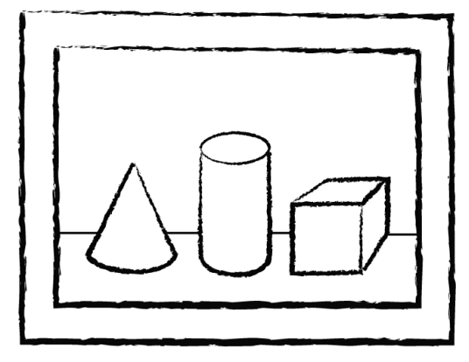
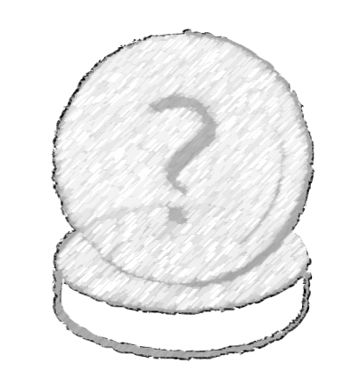
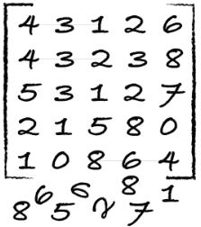
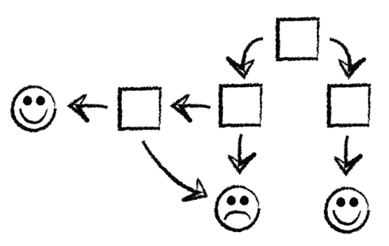
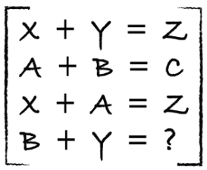
process
identify
predict
1
4
explore
analyze
encode
model
2
3

Slide 7
identify data
Class | Outlook | Temp. | Windy
Play | Sunny | Low | Yes
No Play | Sunny | High | Yes
No Play | Sunny | High | No
Play | Overcast | Low | Yes
Play | Overcast | High | No
Play | Overcast | Low | No
No Play | Rainy | Low | Yes
Play | Rainy | Low | No
? | Sunny | Low | No
label (y)
  play / no play
features
  outlook, temp, windy
values (x)
  [Sunny, Low, Yes]

Slide 8
explore / analyze / clean
Class | Outlook | Temp. | Windy
Play | Sunny | Lowest | Yes
No Play | ? | High | Yes
No Play | Sunny | High | KindOf
Play | Overcast | Low | Yes
Play | Turtle Cloud | High | No
Play | Overcast | ? | No
No Play | Rainy | Low | 28%
Play | Rainy | Low | No
? | Sunny | Low | No
yak shaving
Any apparently useless activity which, by allowing you to overcome intermediate difficulties, allows you to solve a larger problem.
I was doing a bit of yak shaving this morning, and it looks like it might have paid off.
wikipedia

Slide 9
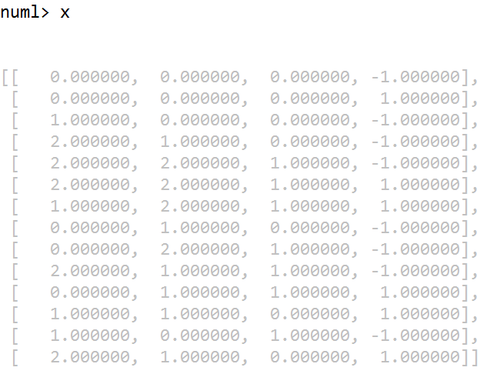
explore / analyze / clean
Class | Outlook | Temp. | Windy
Play | Sunny | Low | Yes
No Play | Sunny | High | Yes
No Play | Sunny | High | No
Play | Overcast | Low | Yes
Play | Overcast | High | No
Play | Overcast | Low | No
No Play | Rainy | Low | Yes
Play | Rainy | Low | No
? | Sunny | Low | No

Slide 10
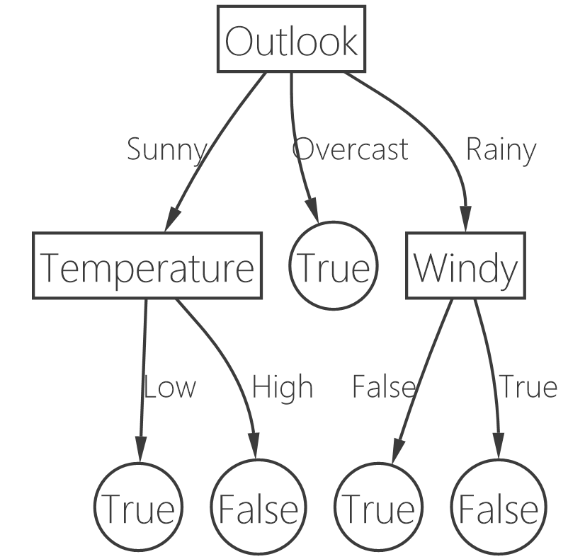
model
Class | Outlook | Temp. | Windy
Play | Sunny | Low | Yes
No Play | Sunny | High | Yes
No Play | Sunny | High | No
Play | Overcast | Low | Yes
Play | Overcast | High | No
Play | Overcast | Low | No
No Play | Rainy | Low | Yes
Play | Rainy | Low | No
? | Sunny | Low | No

Slide 11
predict
Class | Outlook | Temp. | Windy
? | Sunny | Low | No
PLAY!!!

Slide 12
how well is it doing?
train
test
Use ~80%
Use ~20%

Slide 13
how well is it doing?
train
test
dev
Use ~80%
Use ~10%
Use ~10%

Slide 14
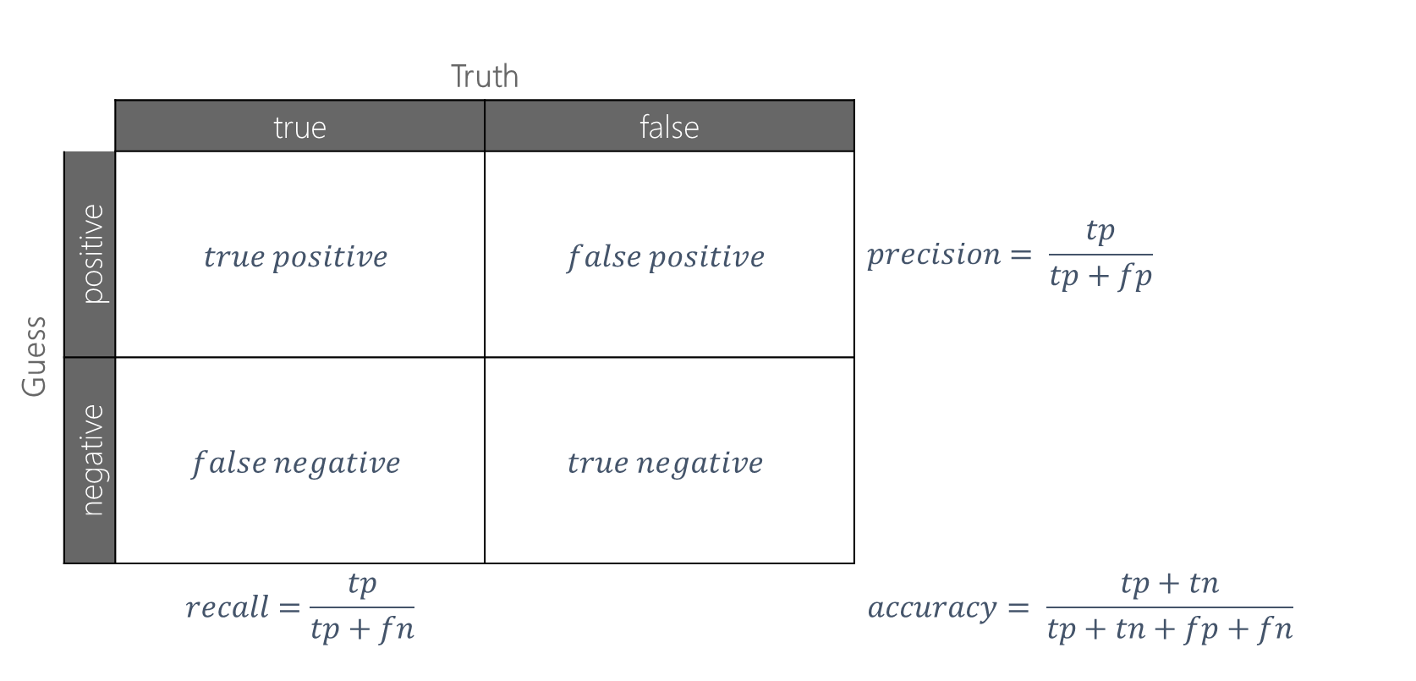
confusion matrix
 |  | Truth
 |  | true | false
Guess | positive | $$true positive$$ | $$false positive$$ | $$precision= \frac{tp}{tp+fp}$$
 | negative | $$false negative$$ | $$true negative$$
 |  | $$recall=\frac{tp}{tp+fn}$$ |  | $$accuracy= \frac{tp+tn}{tp+tn+fp+fn}$$

Slide 15


Slide 16
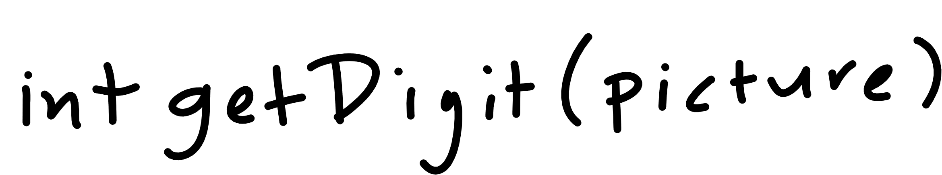

Slide 17
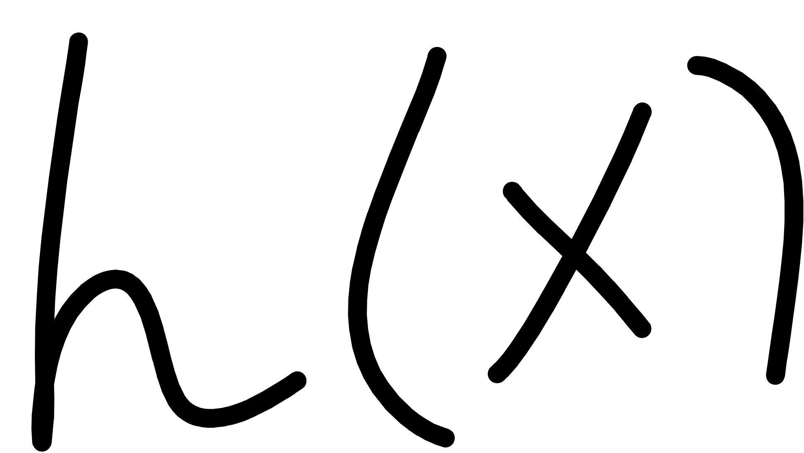
Notes:
Cover the fact that ML uses data to make its own functions

Slide 18
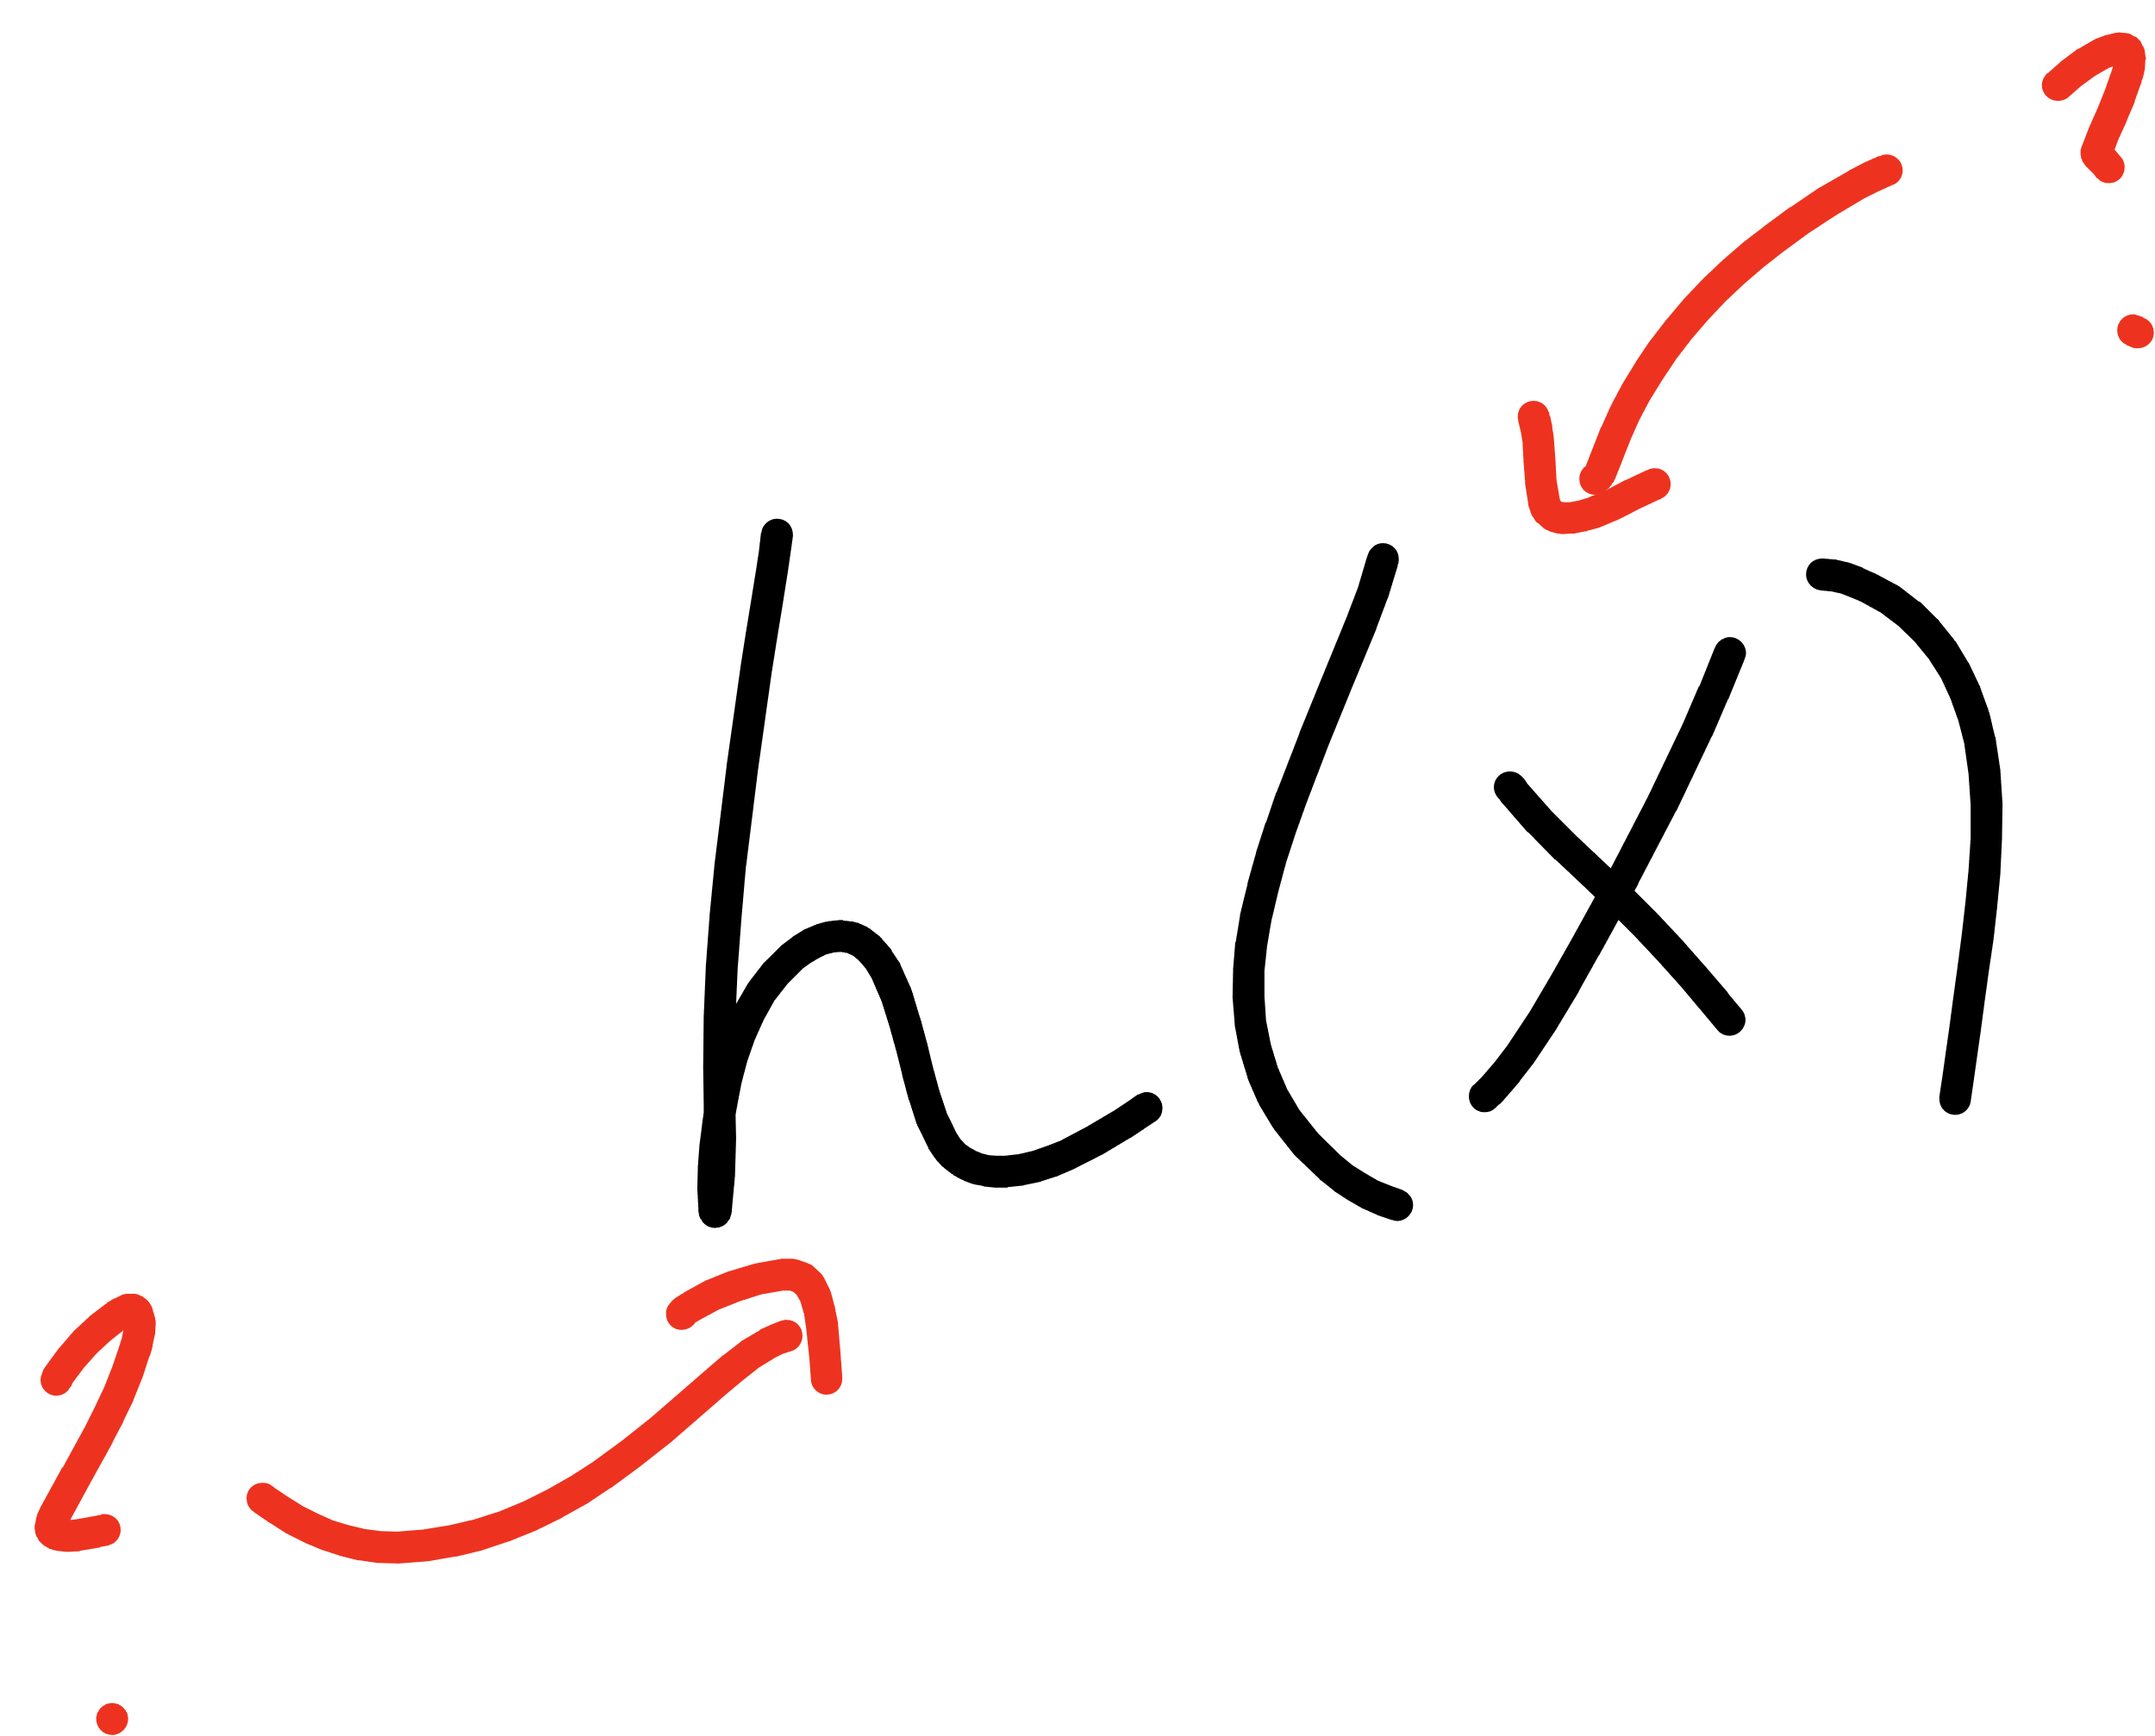
Notes:
Open mnist data representation

Slide 19
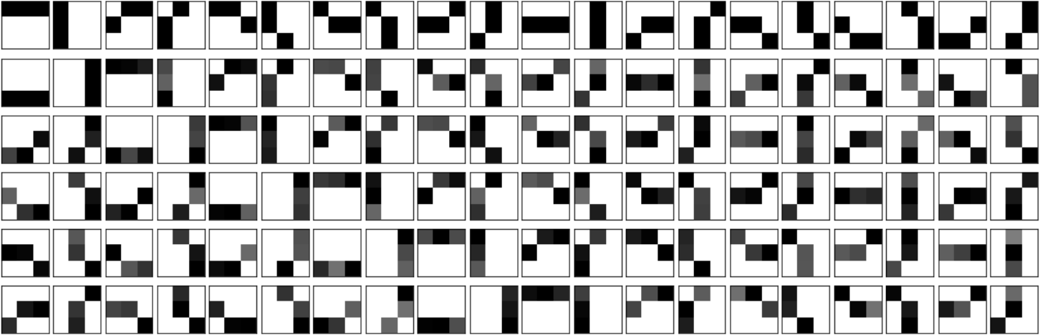

Slide 20
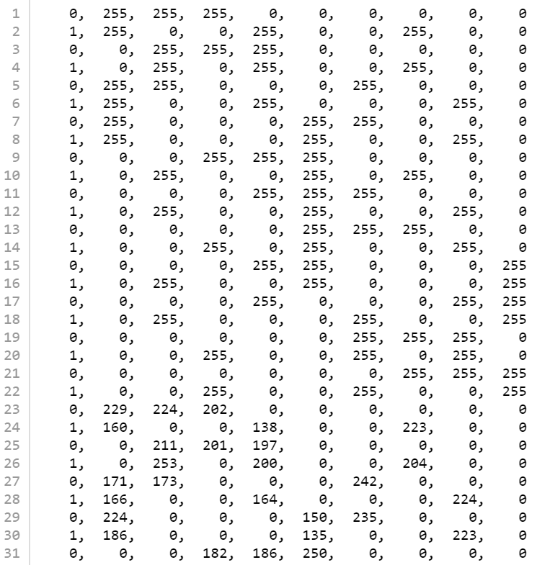


Slide 21
finding an h
in order to classify things properly we need:
  a way to mathematically represent examples
  a way to separate classes (yes/no)
“decision boundary”
excel example
graph example

Slide 22
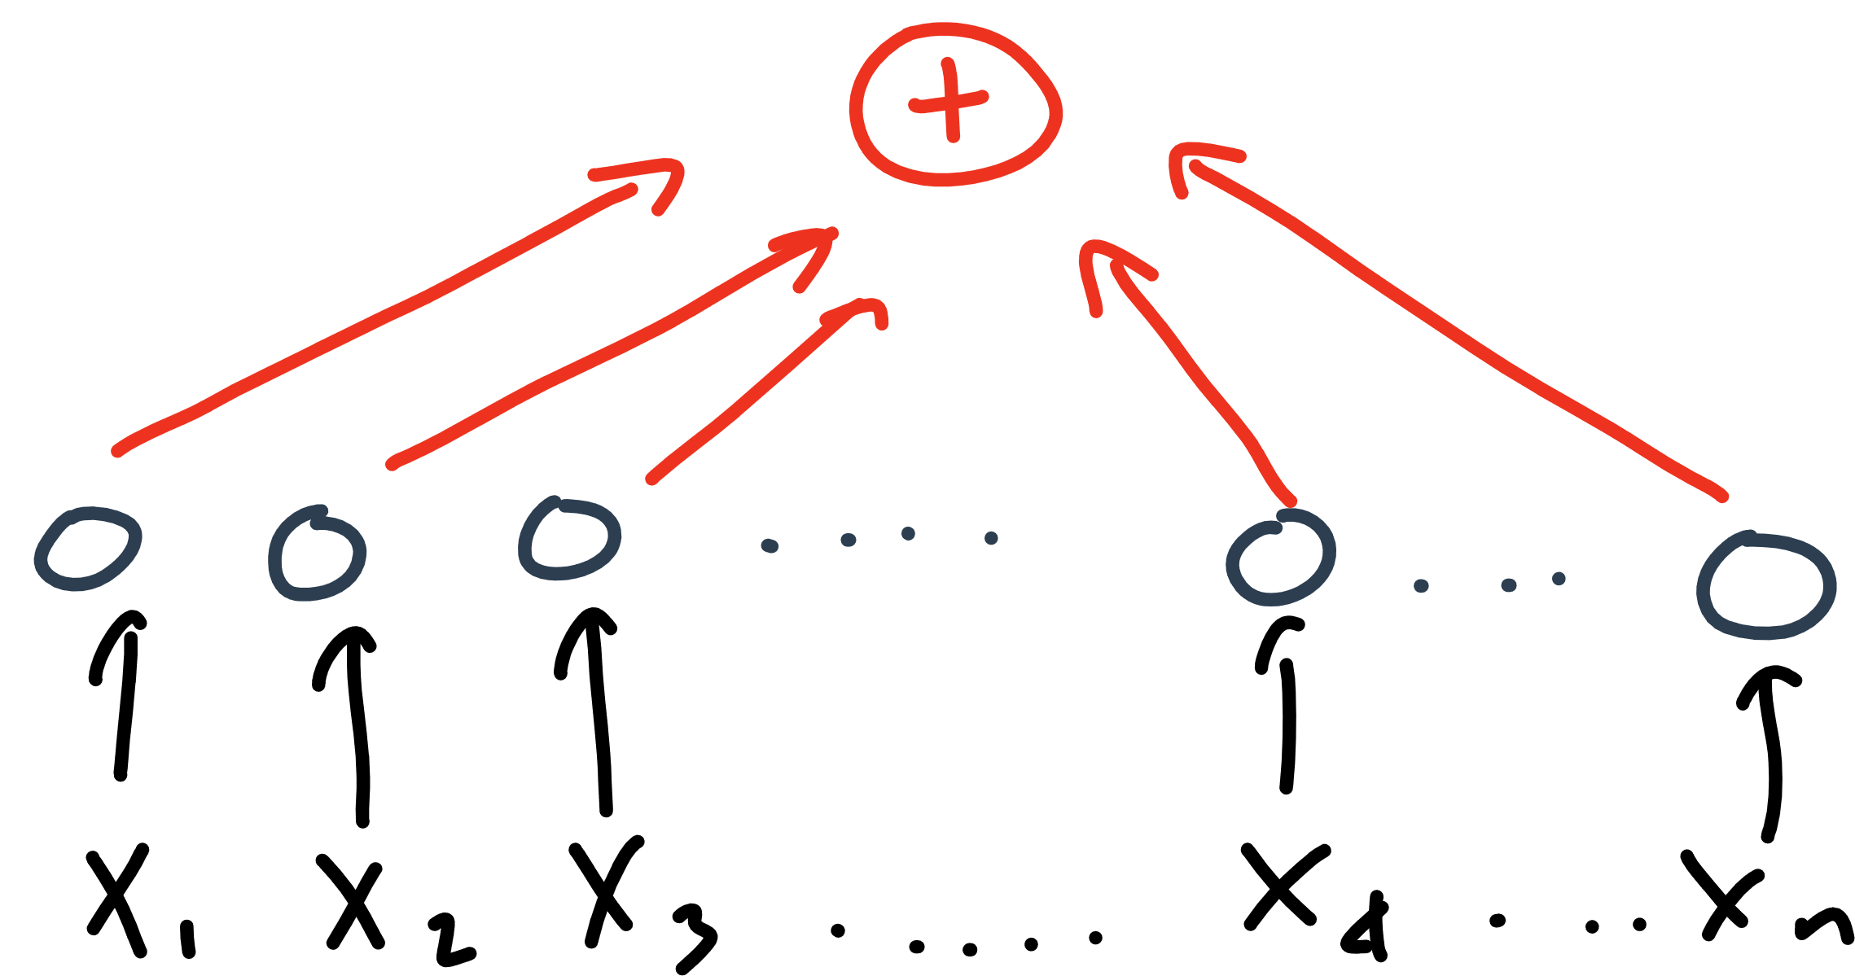

Slide 23
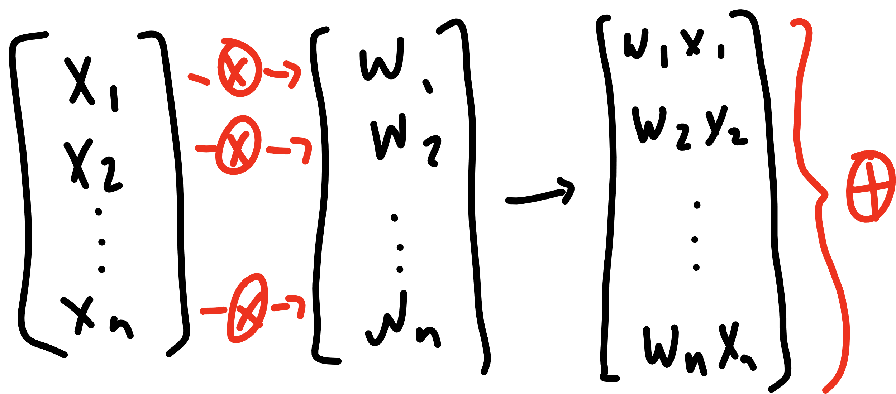

Slide 24
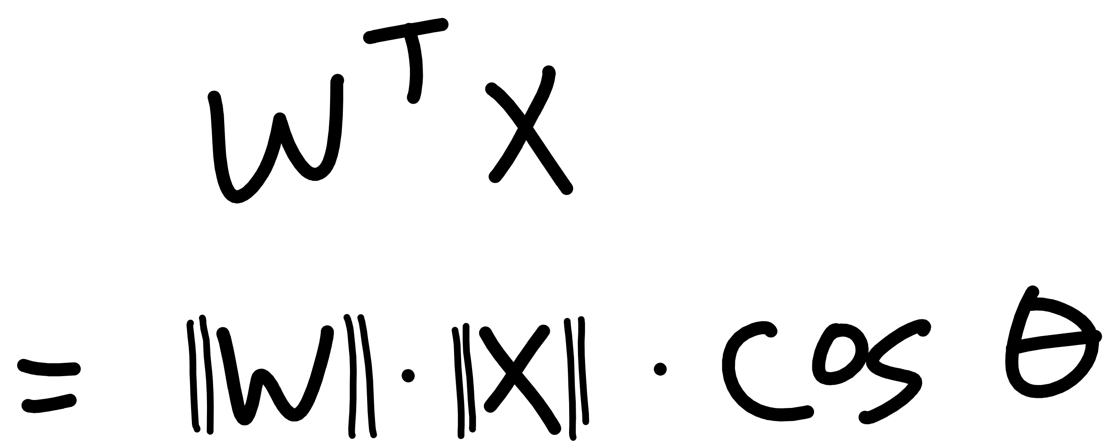

Slide 25
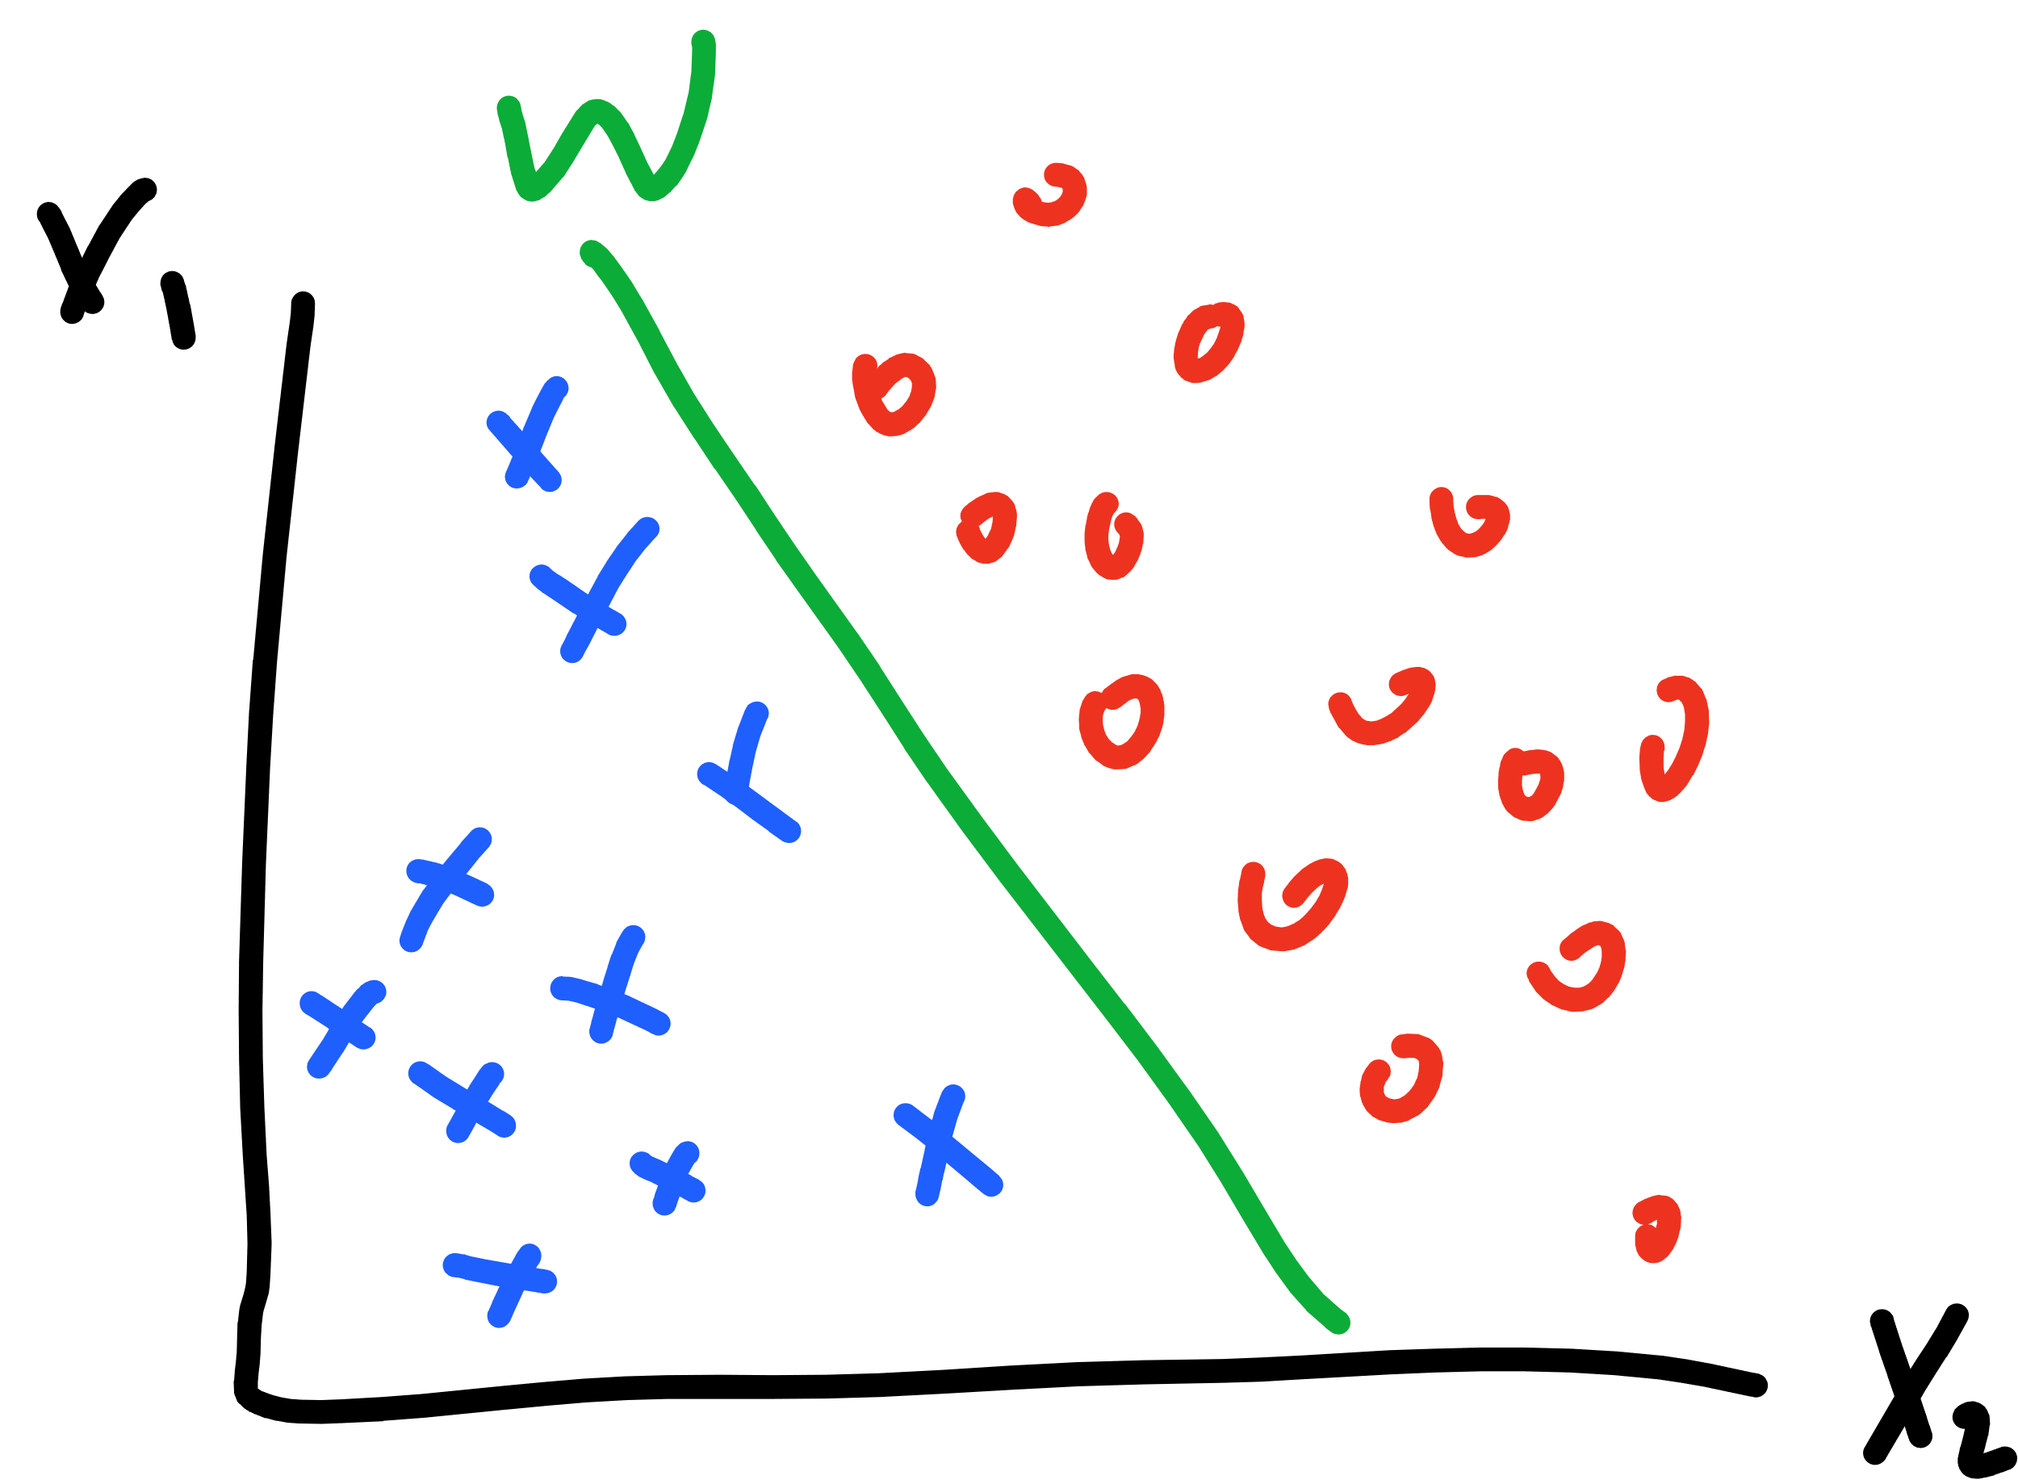

Slide 26
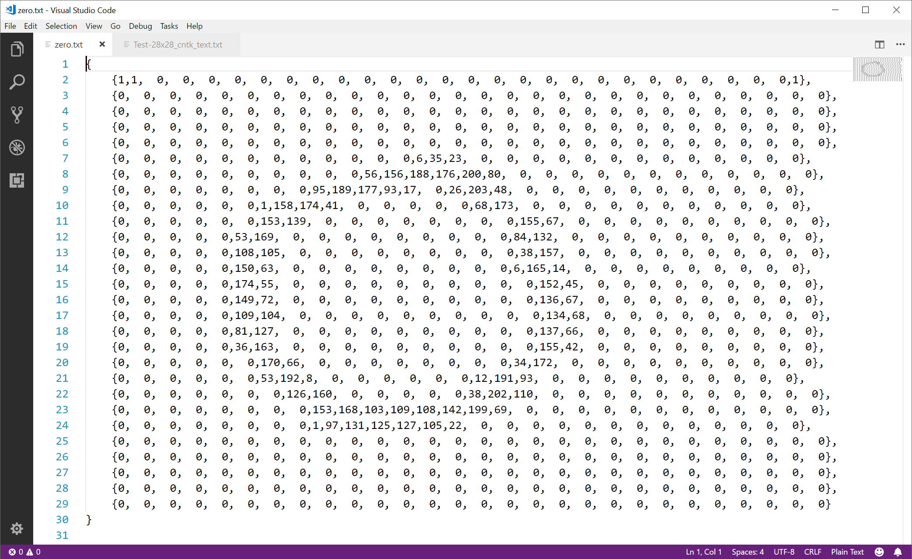

Slide 27
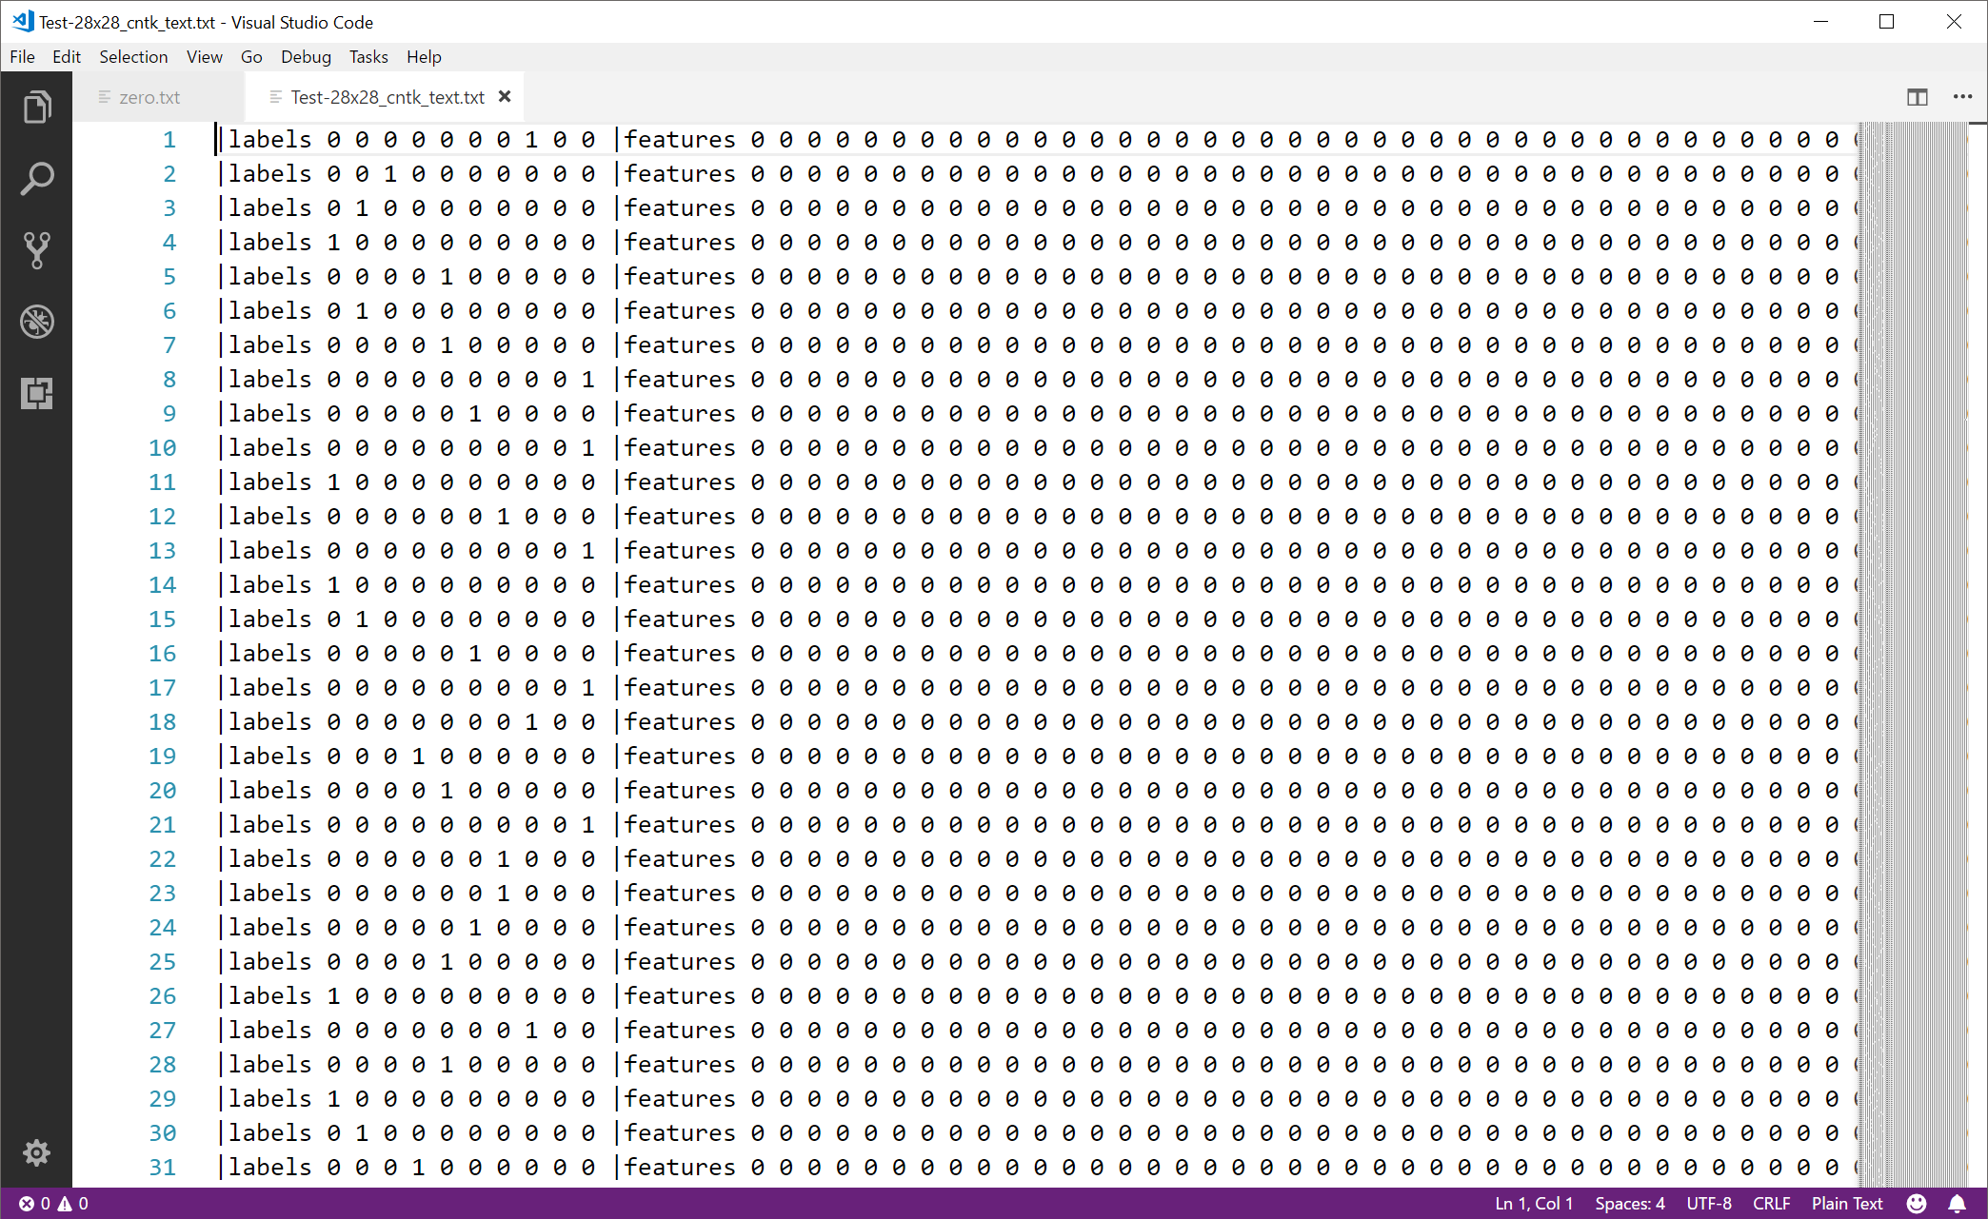

Slide 28
Notes:
Single output
What about one-hot encoded?

Slide 29
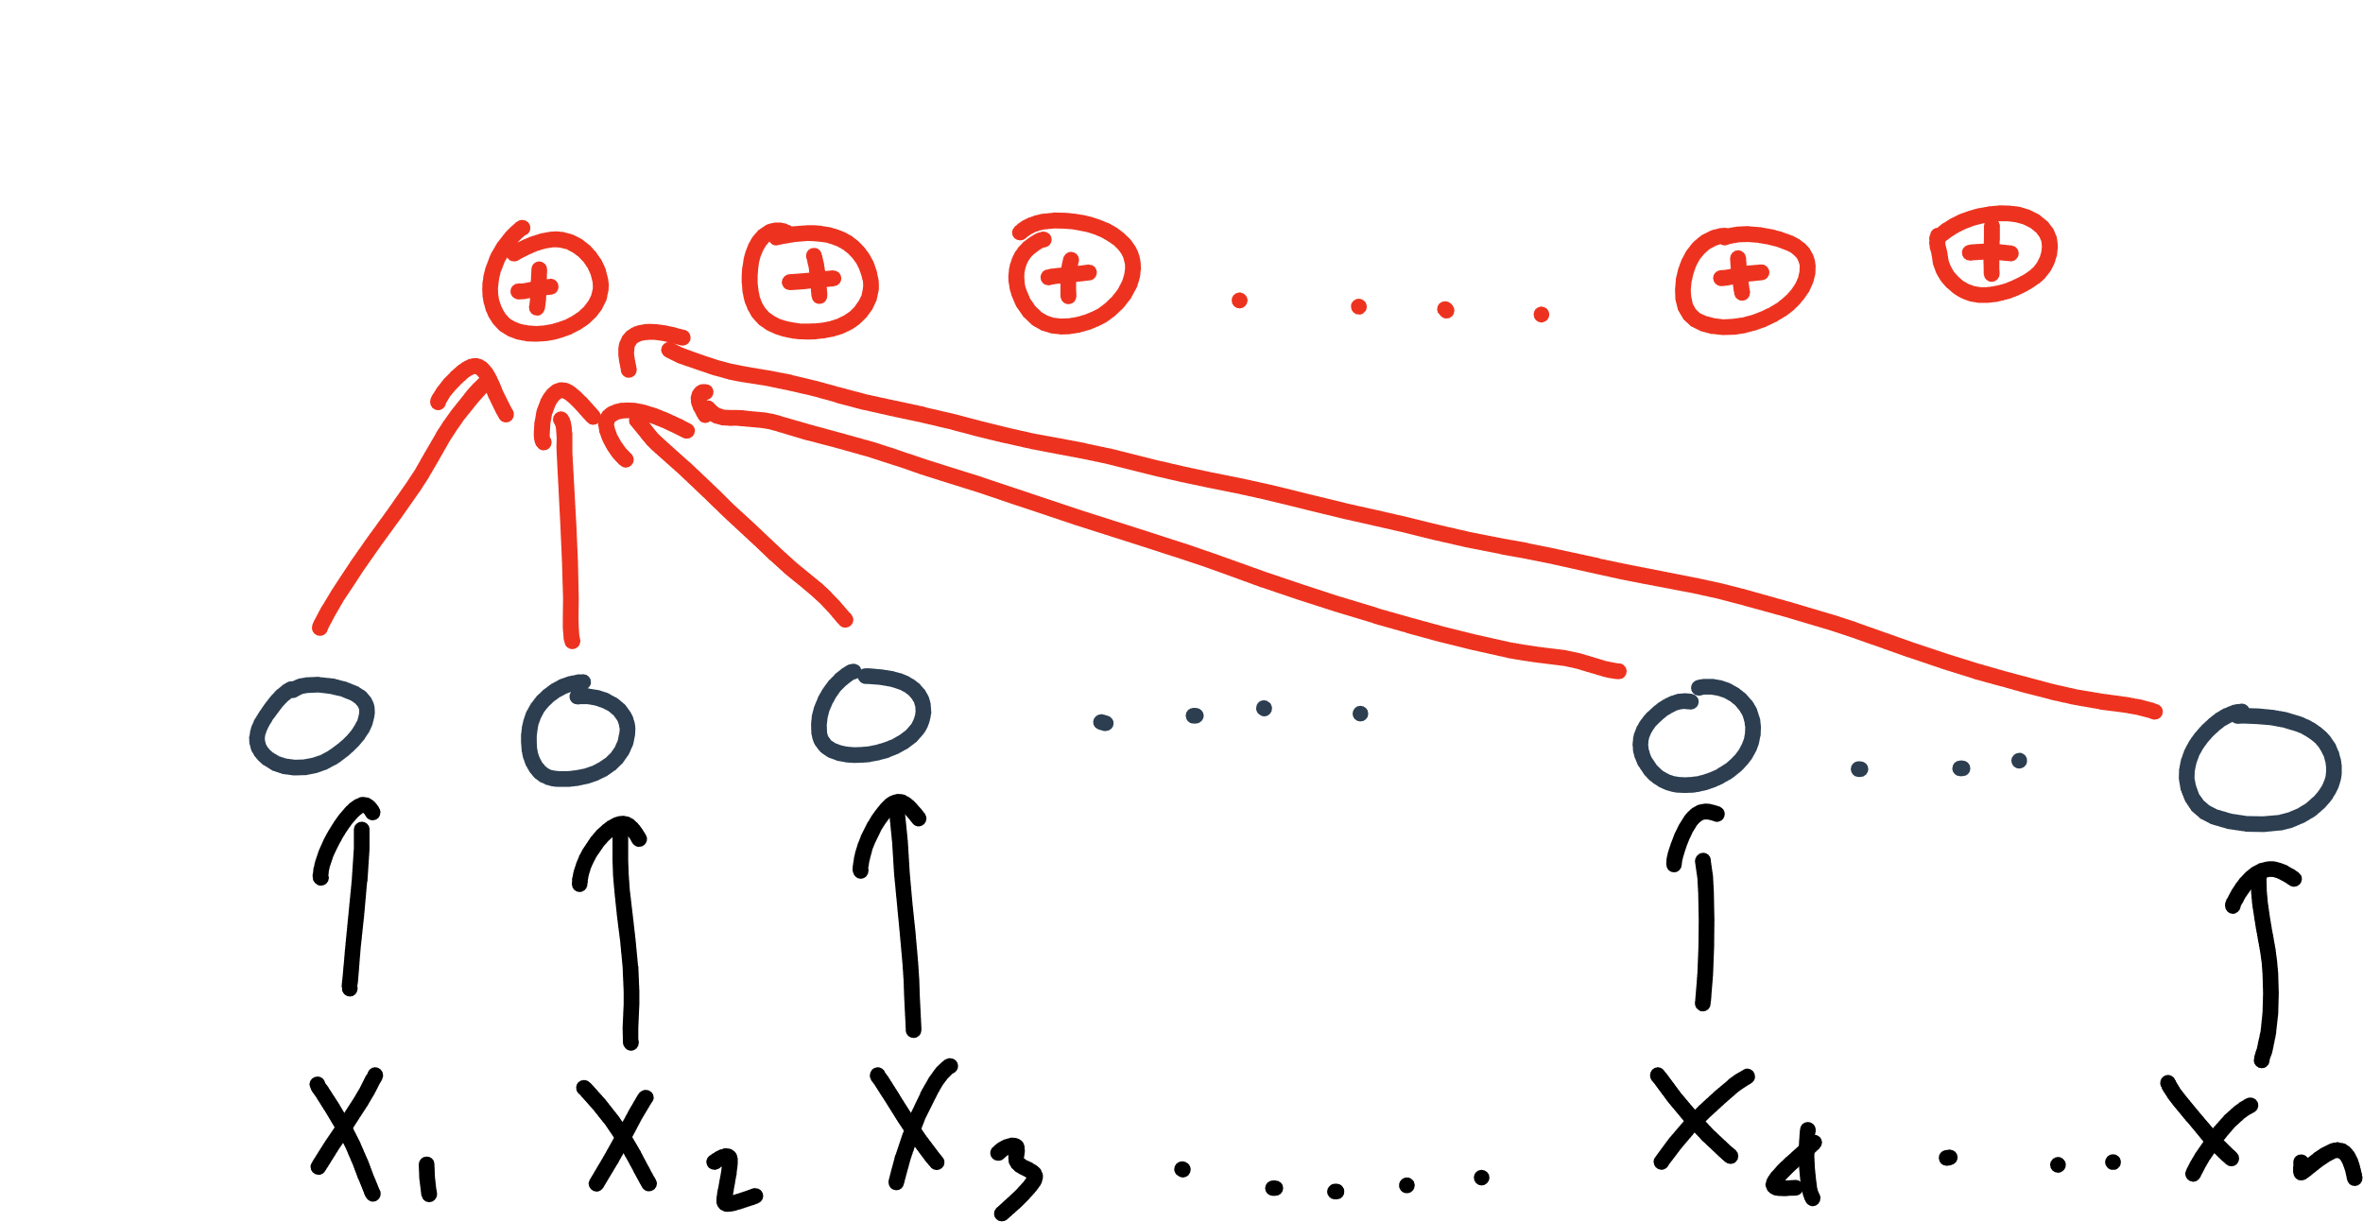

Slide 30
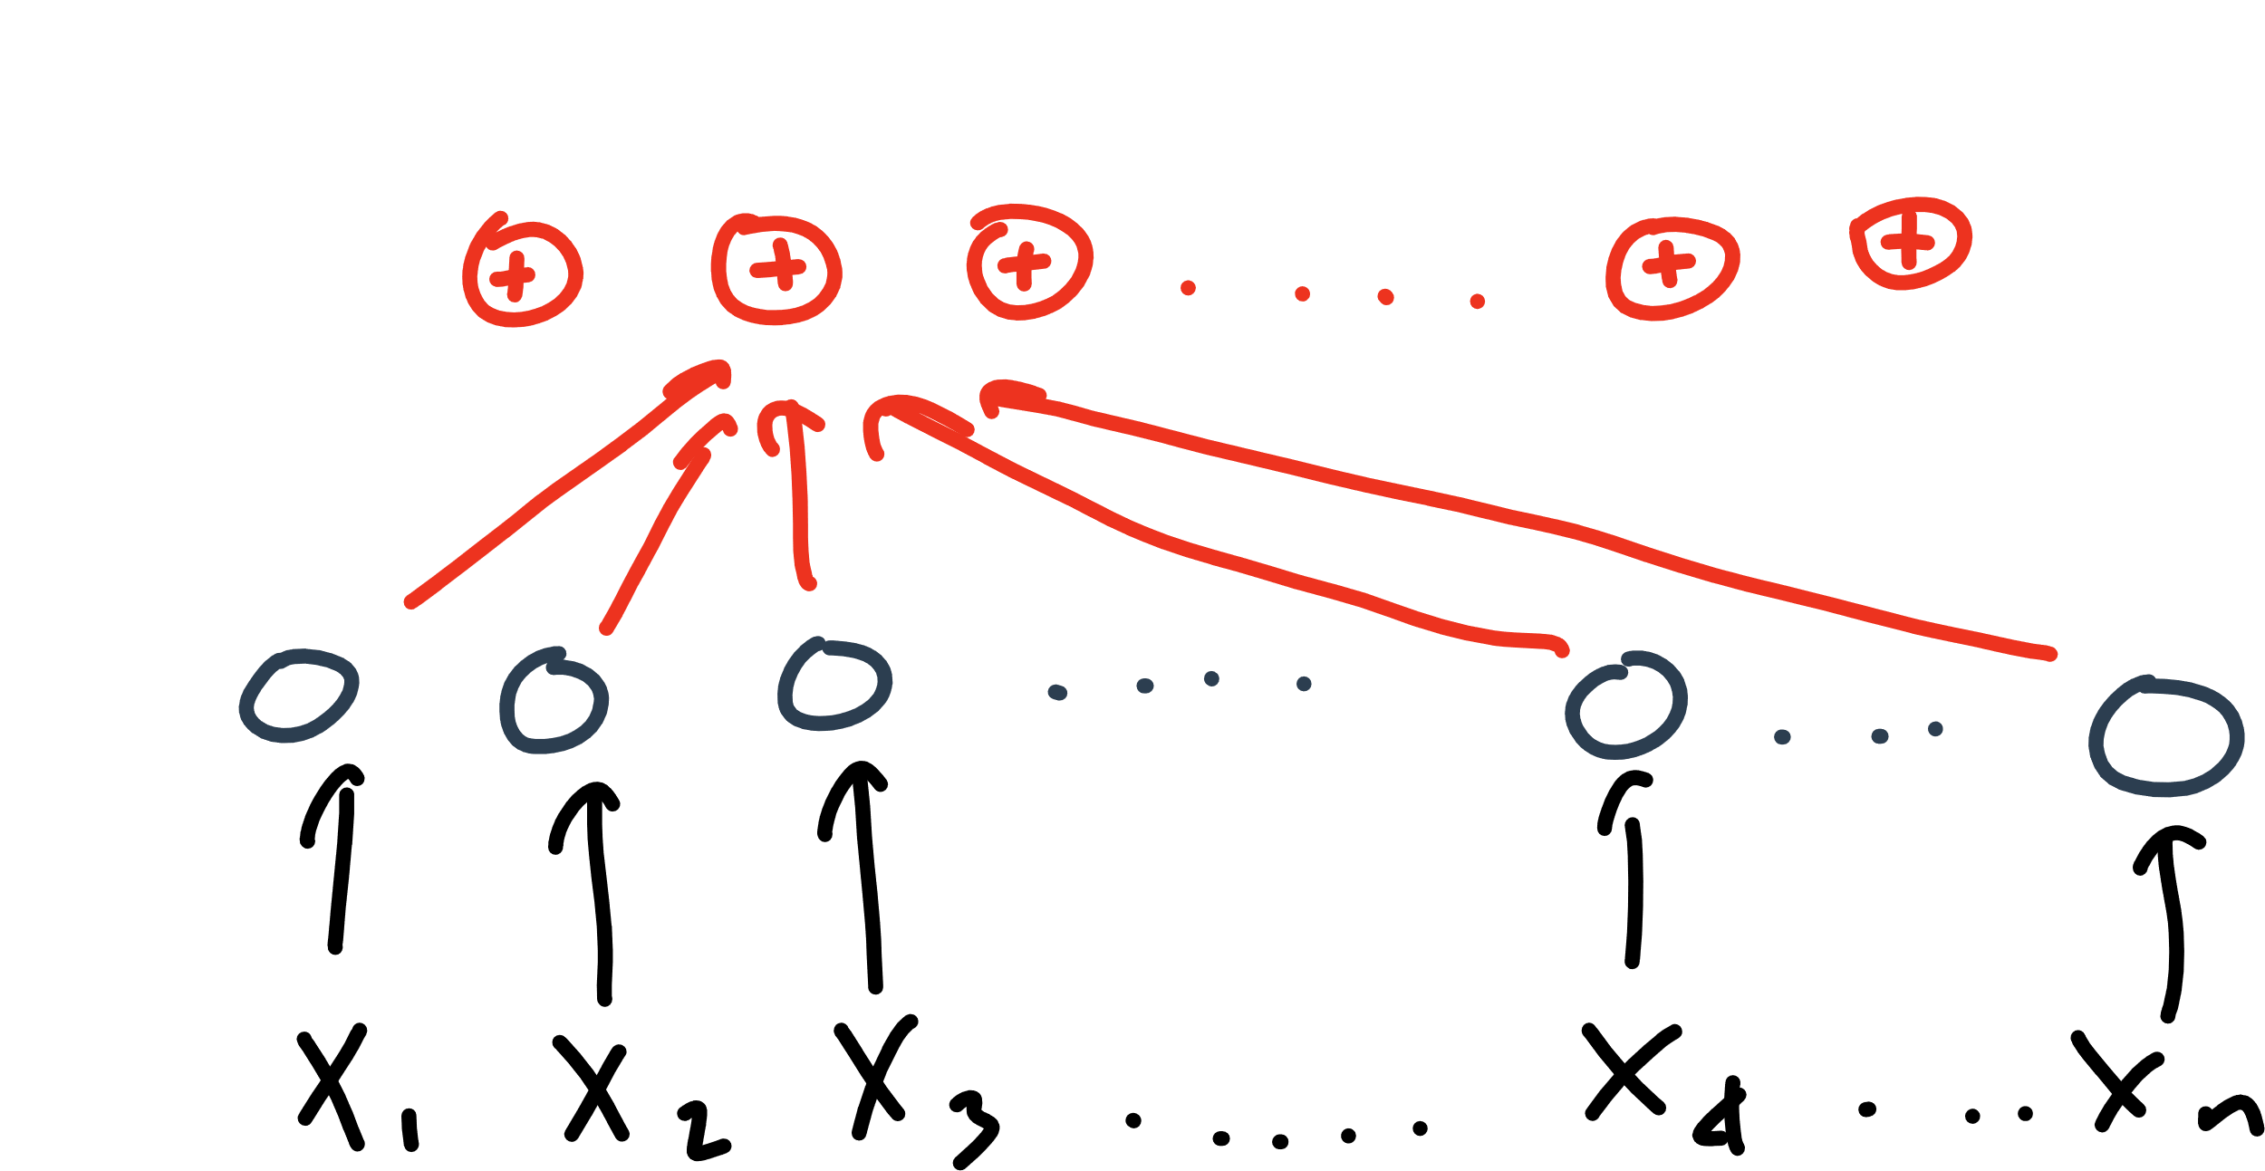

Slide 31
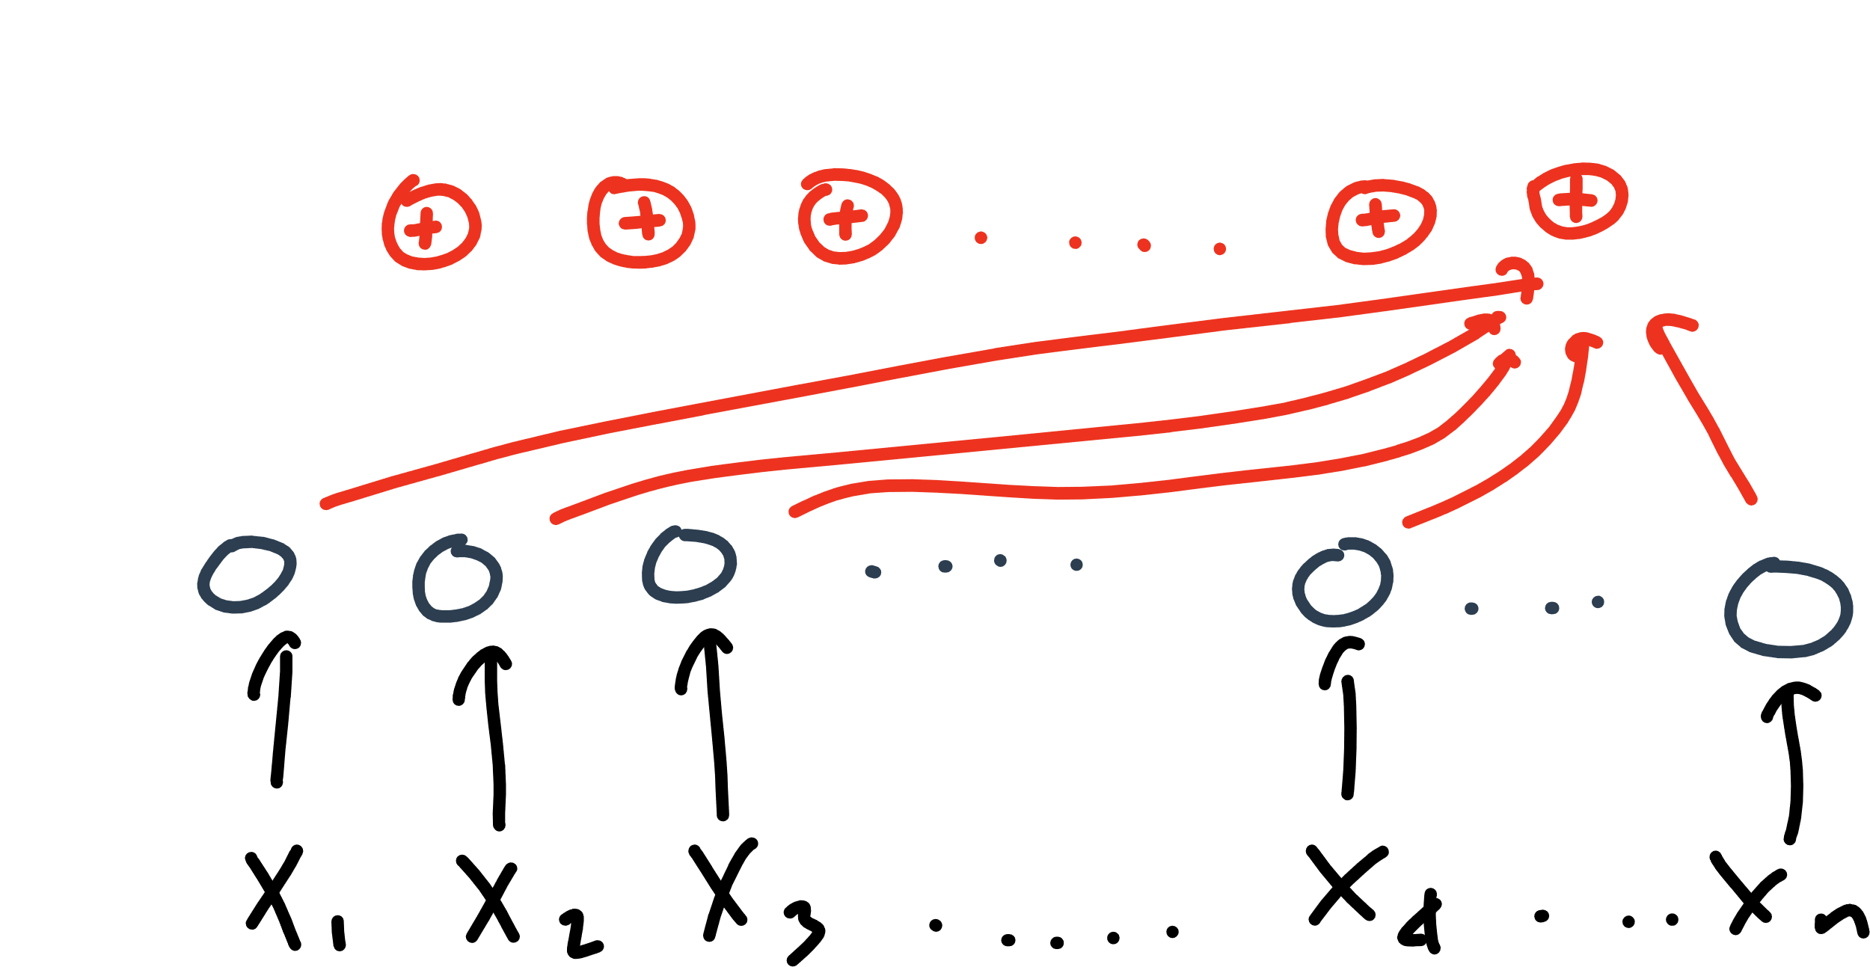

Slide 32
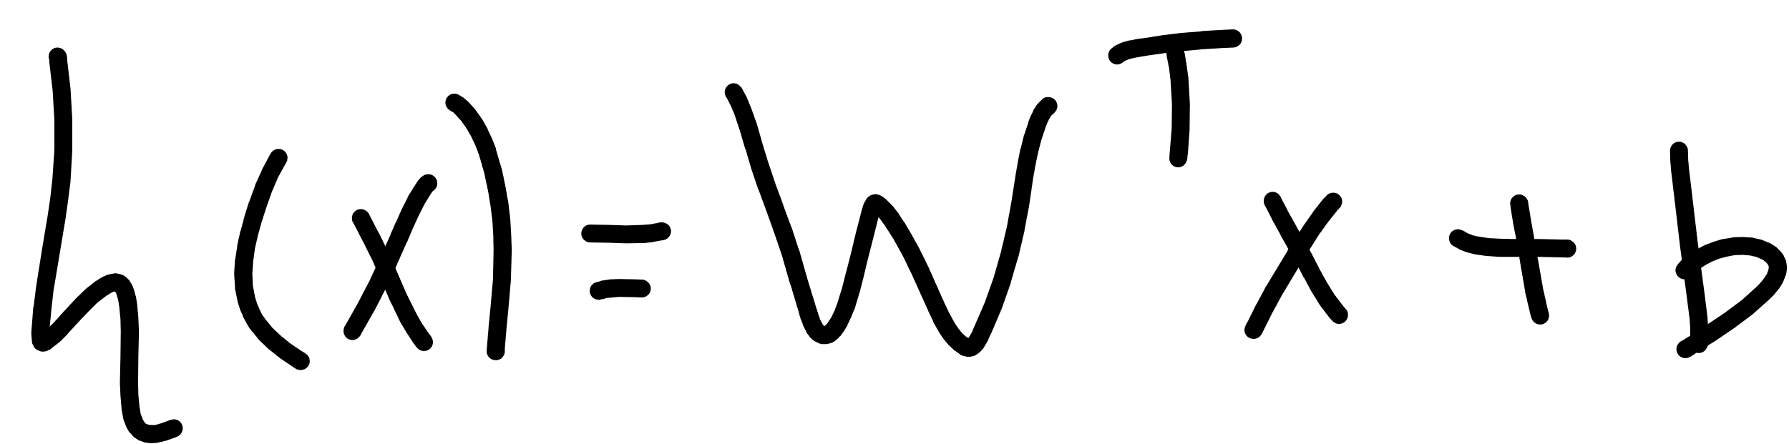

Slide 33
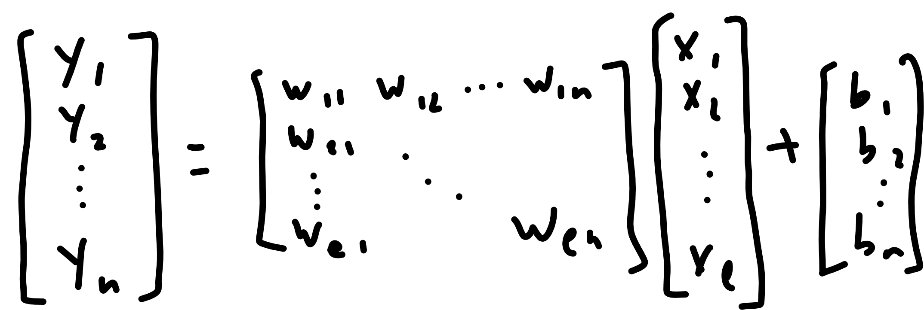

Slide 34


Slide 35
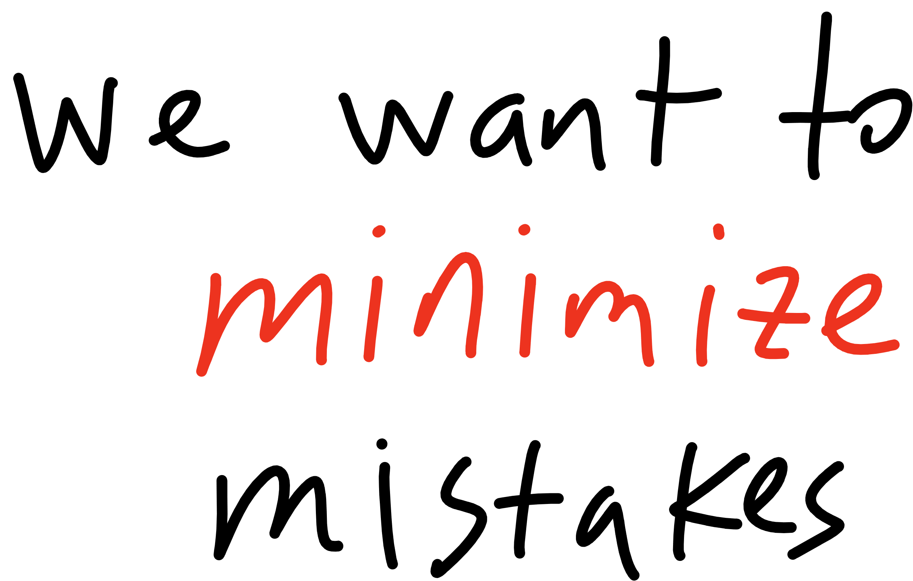

Slide 36
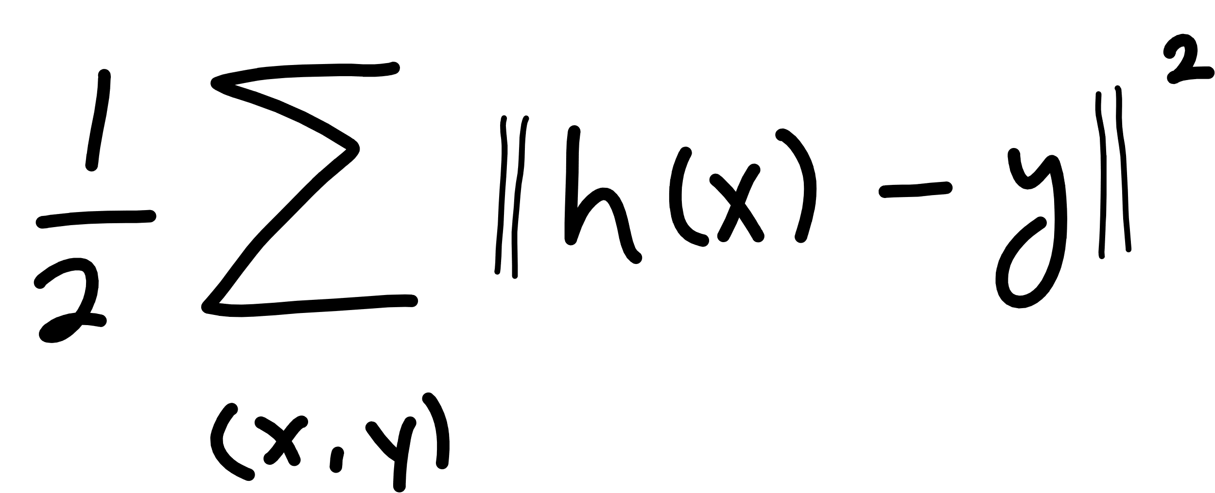
Notes:
Cost function
(WHERE IS W???)

Slide 37
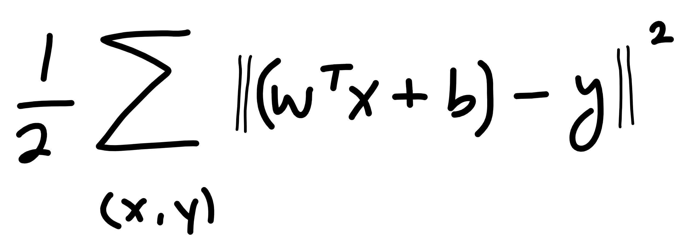

Slide 38
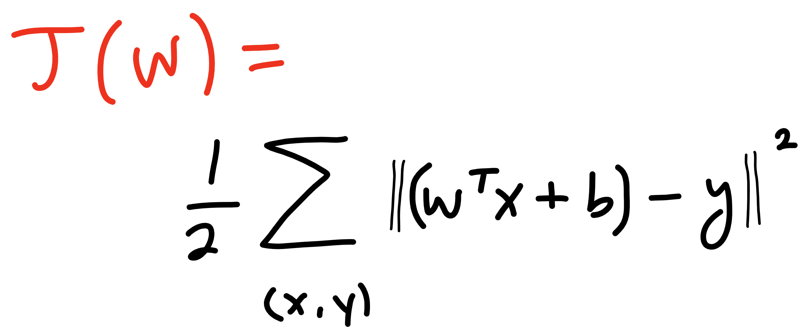

Slide 39
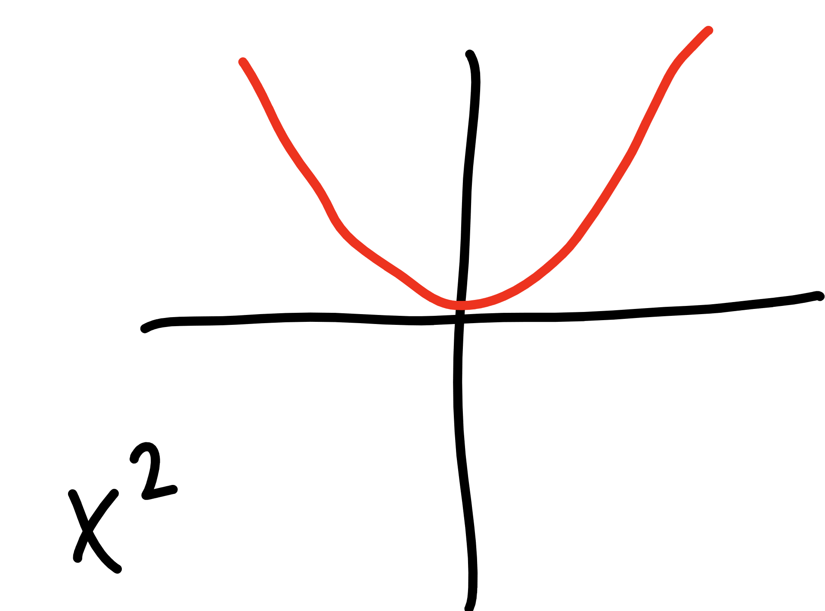

Slide 40
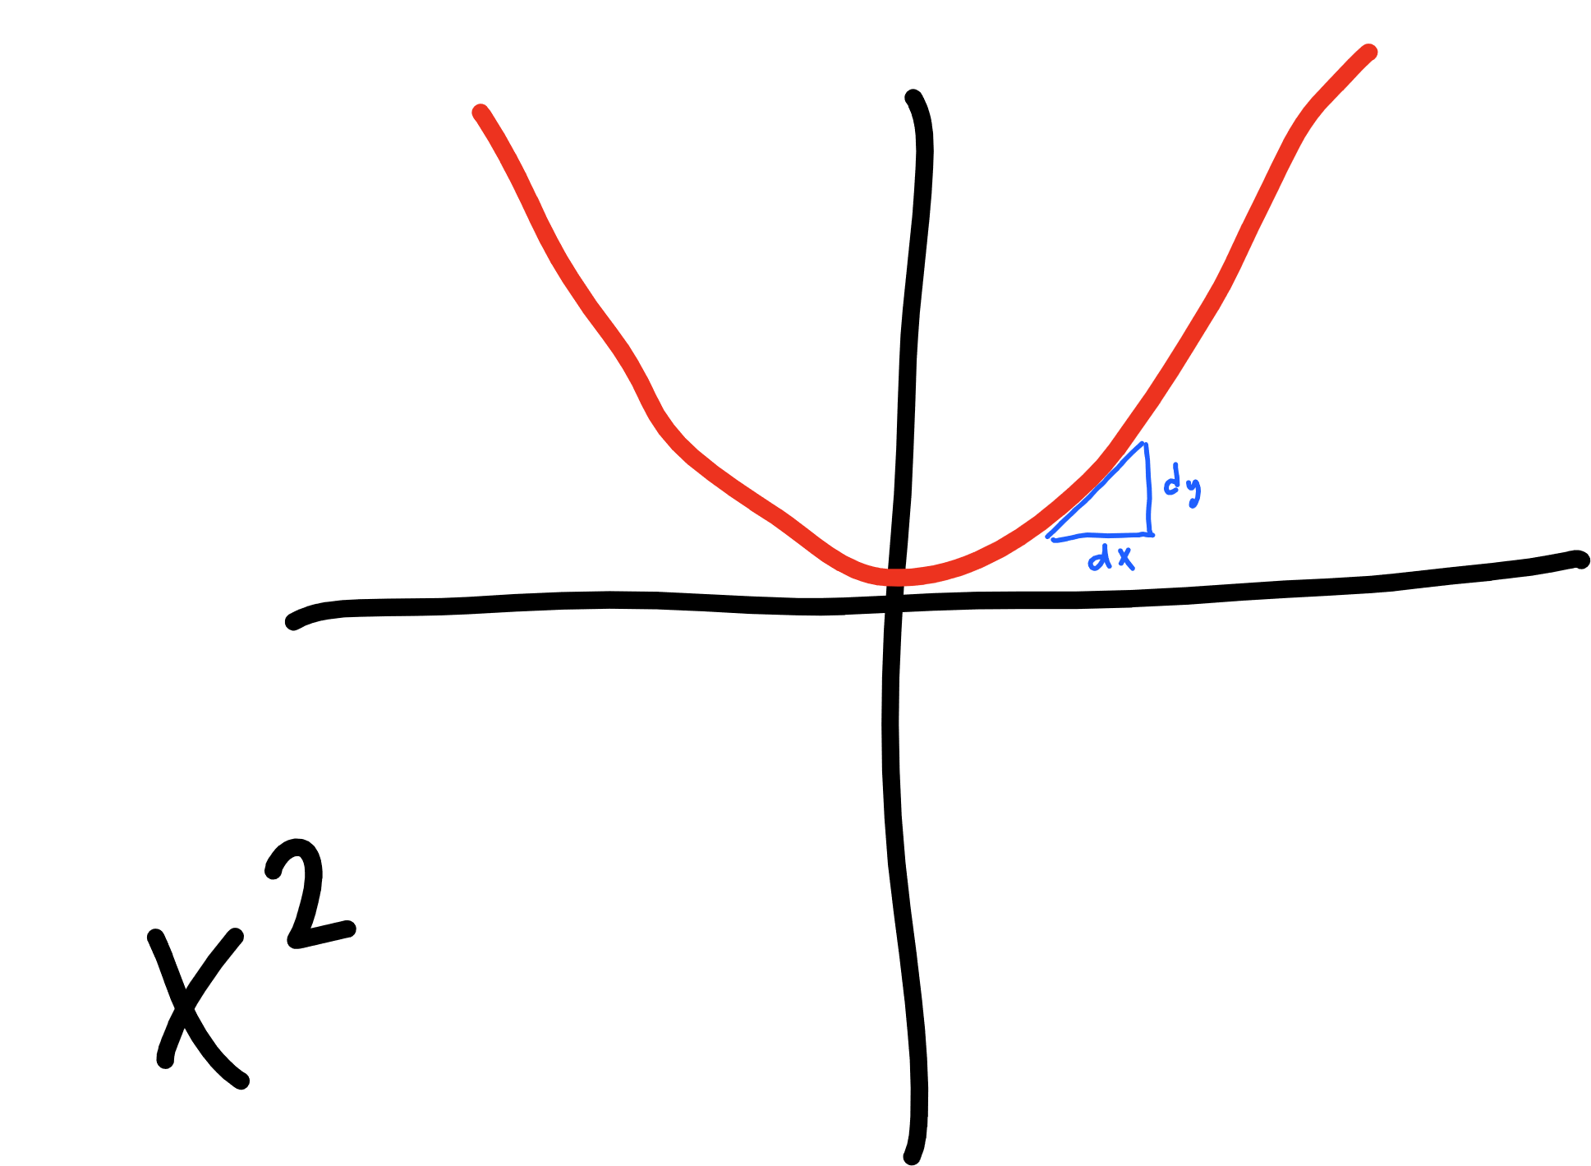

Slide 41
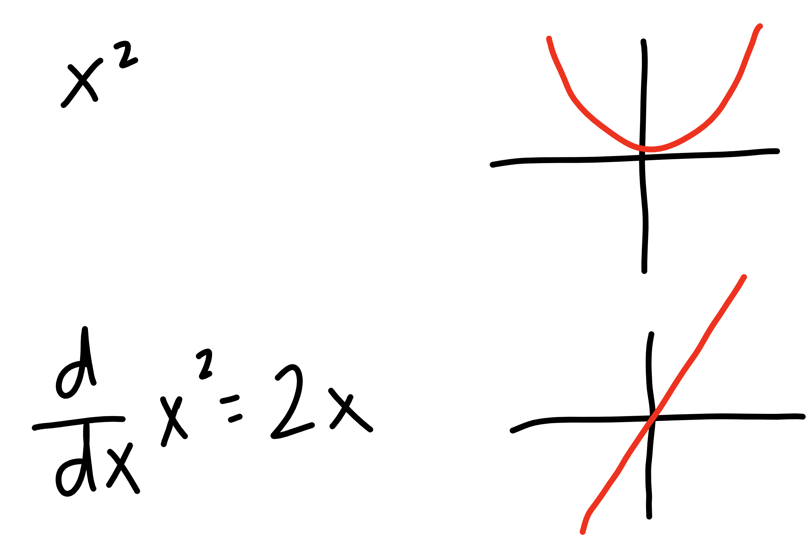

Slide 42
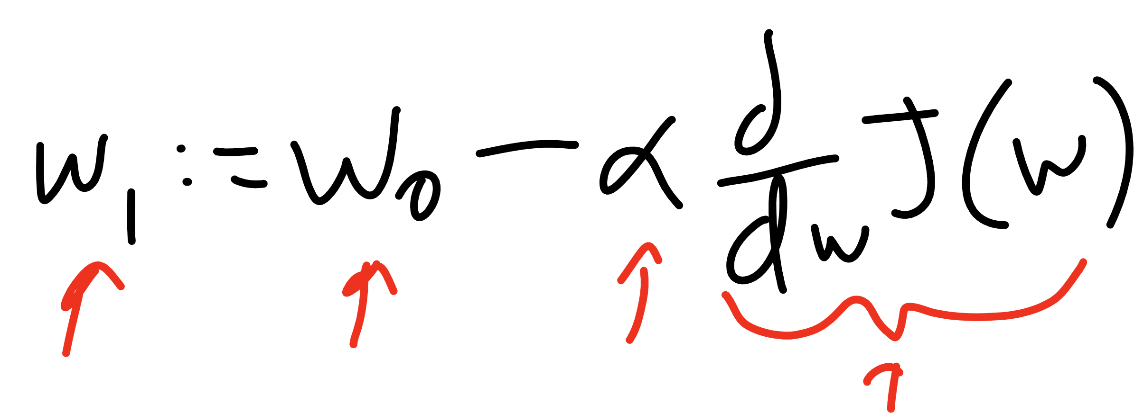
Current W
Learning Rate
Updated W
Derivative of
Cost Function

Slide 43
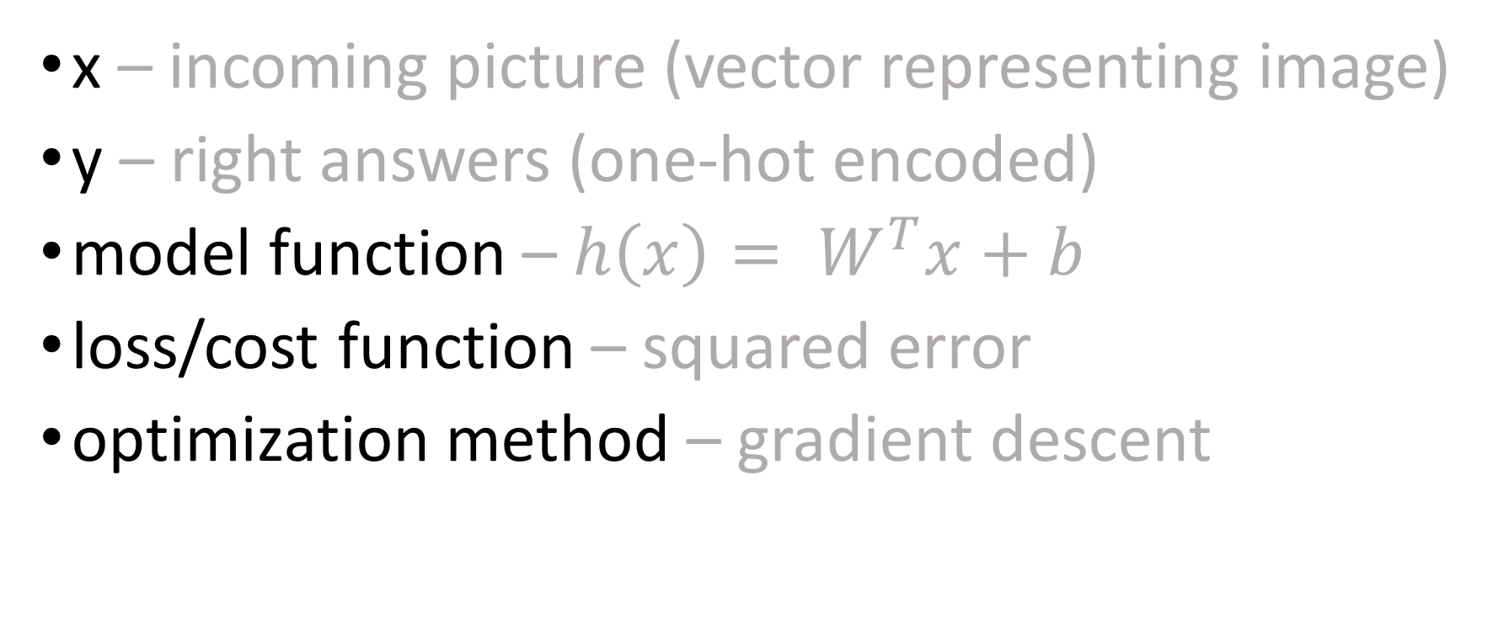
so far…
x – incoming picture (vector representing image)
y – right answers (one-hot encoded)
model function – $h\left(x\right)= W^{T}x+b$
loss/cost function – squared error
optimization method – gradient descent

Slide 44
TensorFlow
Step 1 – Define a Graph
Step 2 – Start a Session
Step 3 – Run!

Slide 45
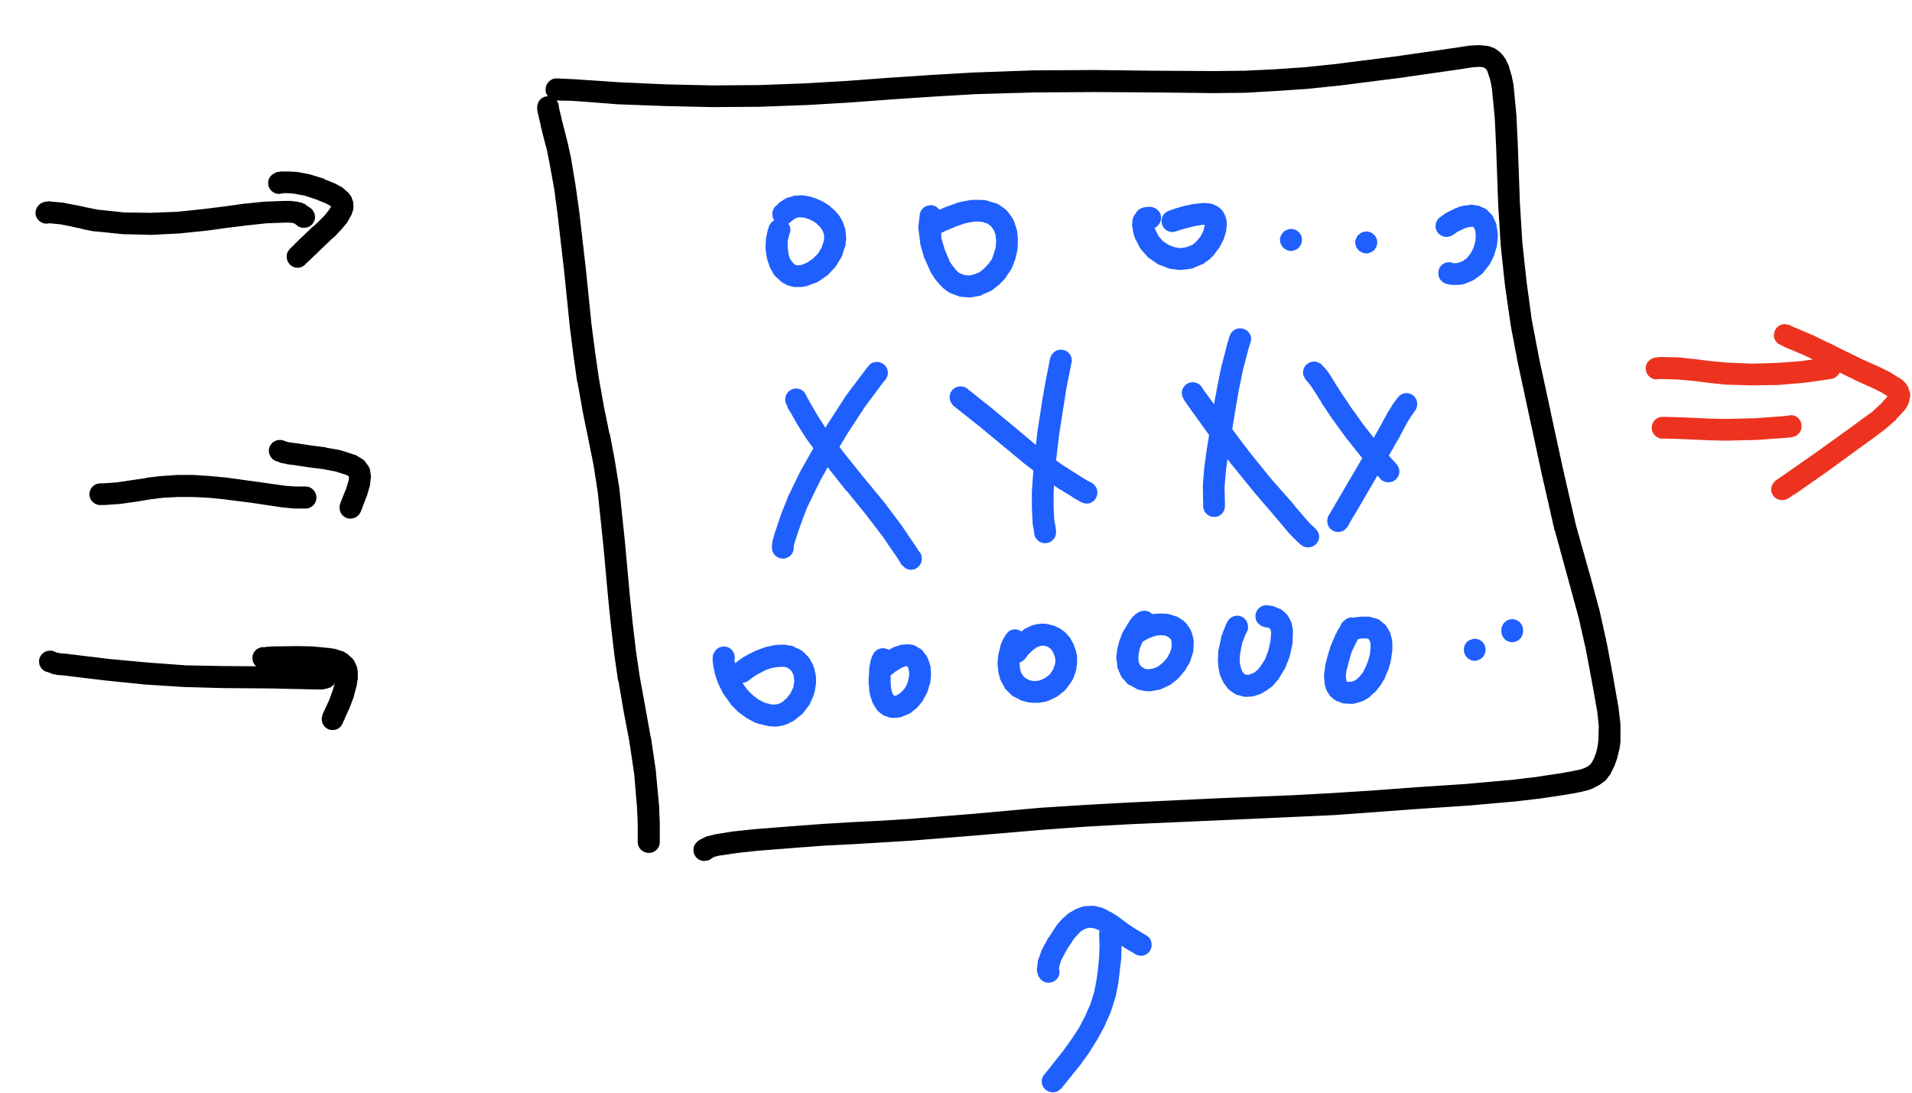
TensorFlow – Building the Graph
placeholders
graph
variables
constants
x, y, model, cost, accuracy, optimization…

Slide 46
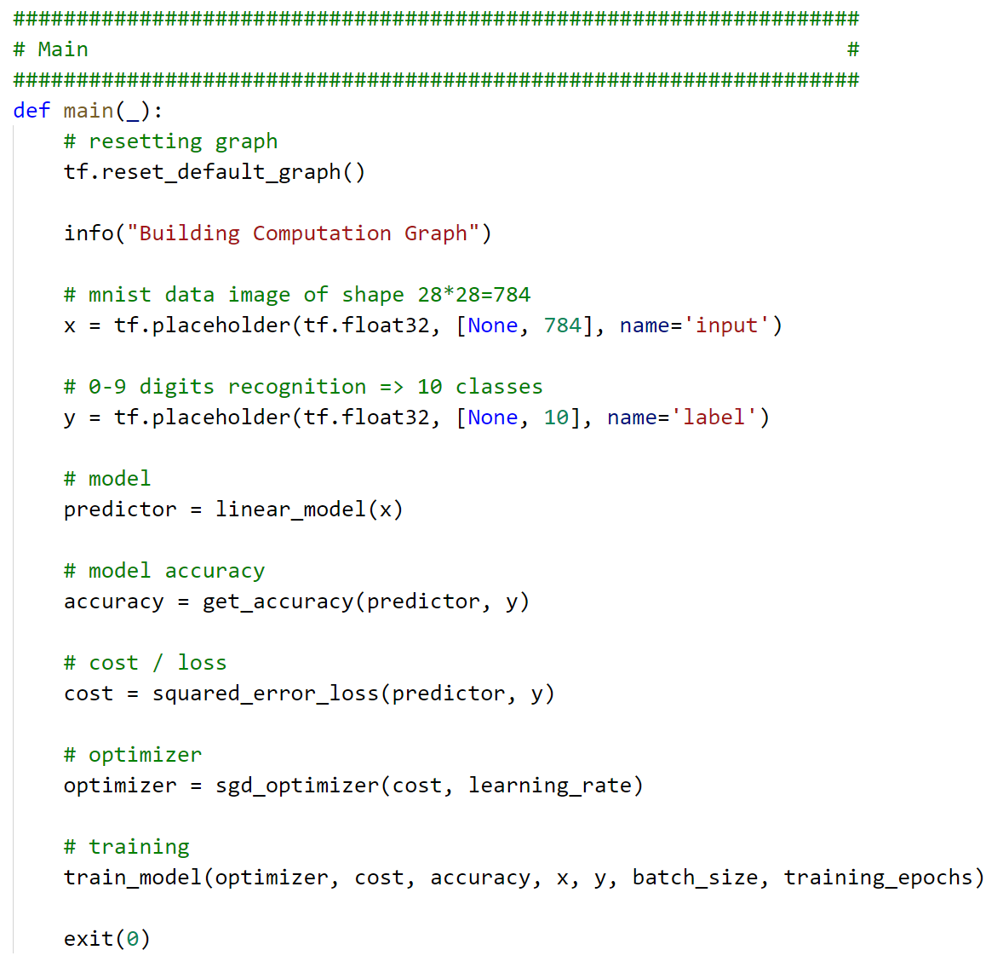

Slide 47
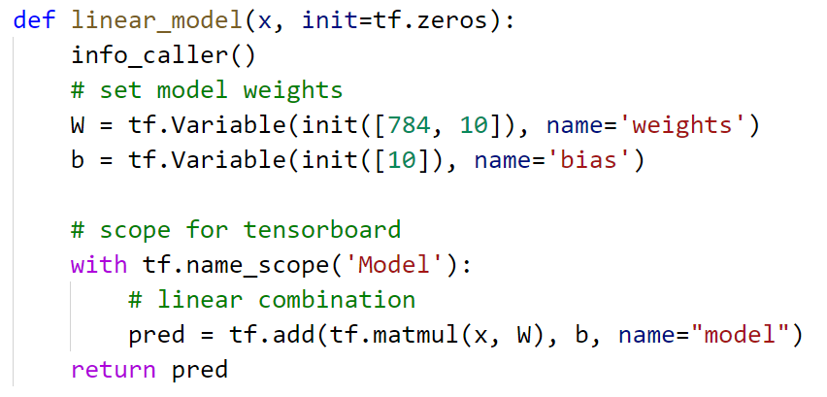


Slide 48
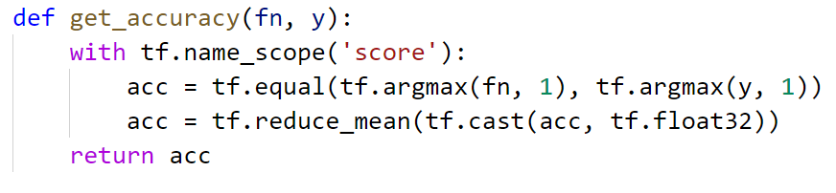


Slide 49
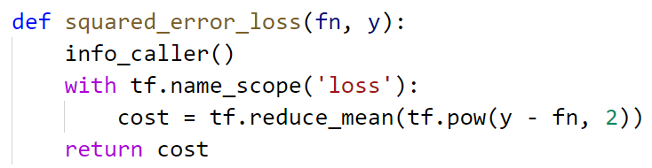

Slide 50
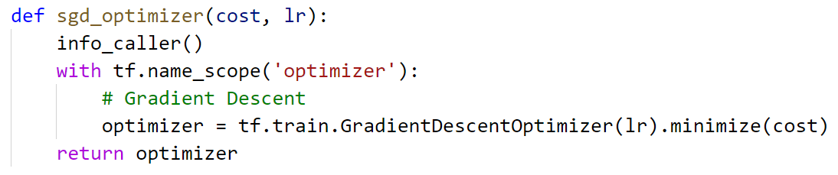


Slide 51
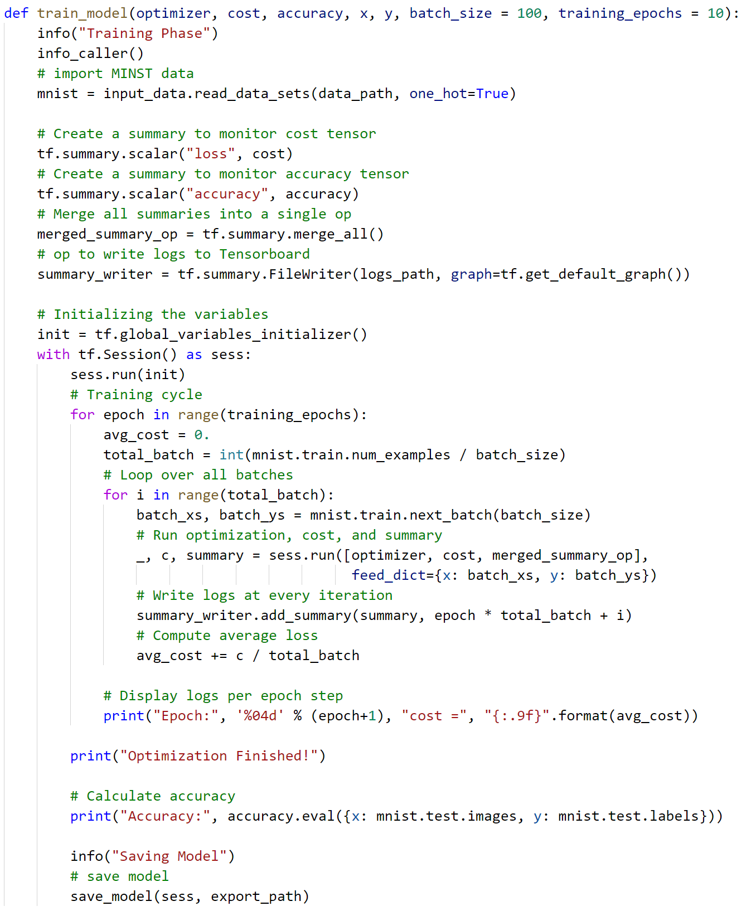

Slide 52


Slide 53
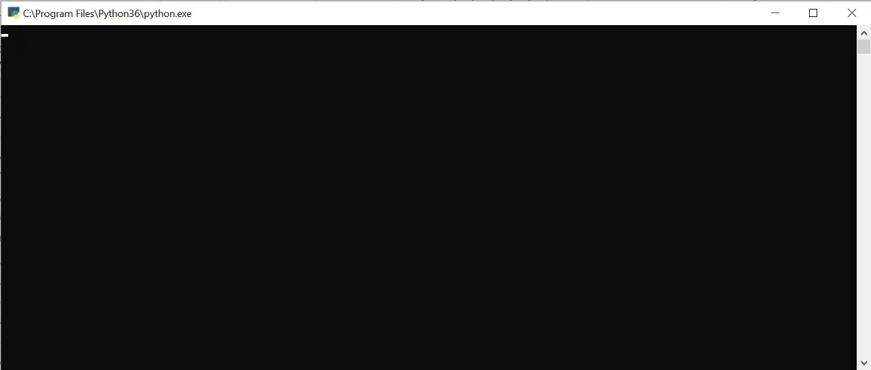

Slide 54
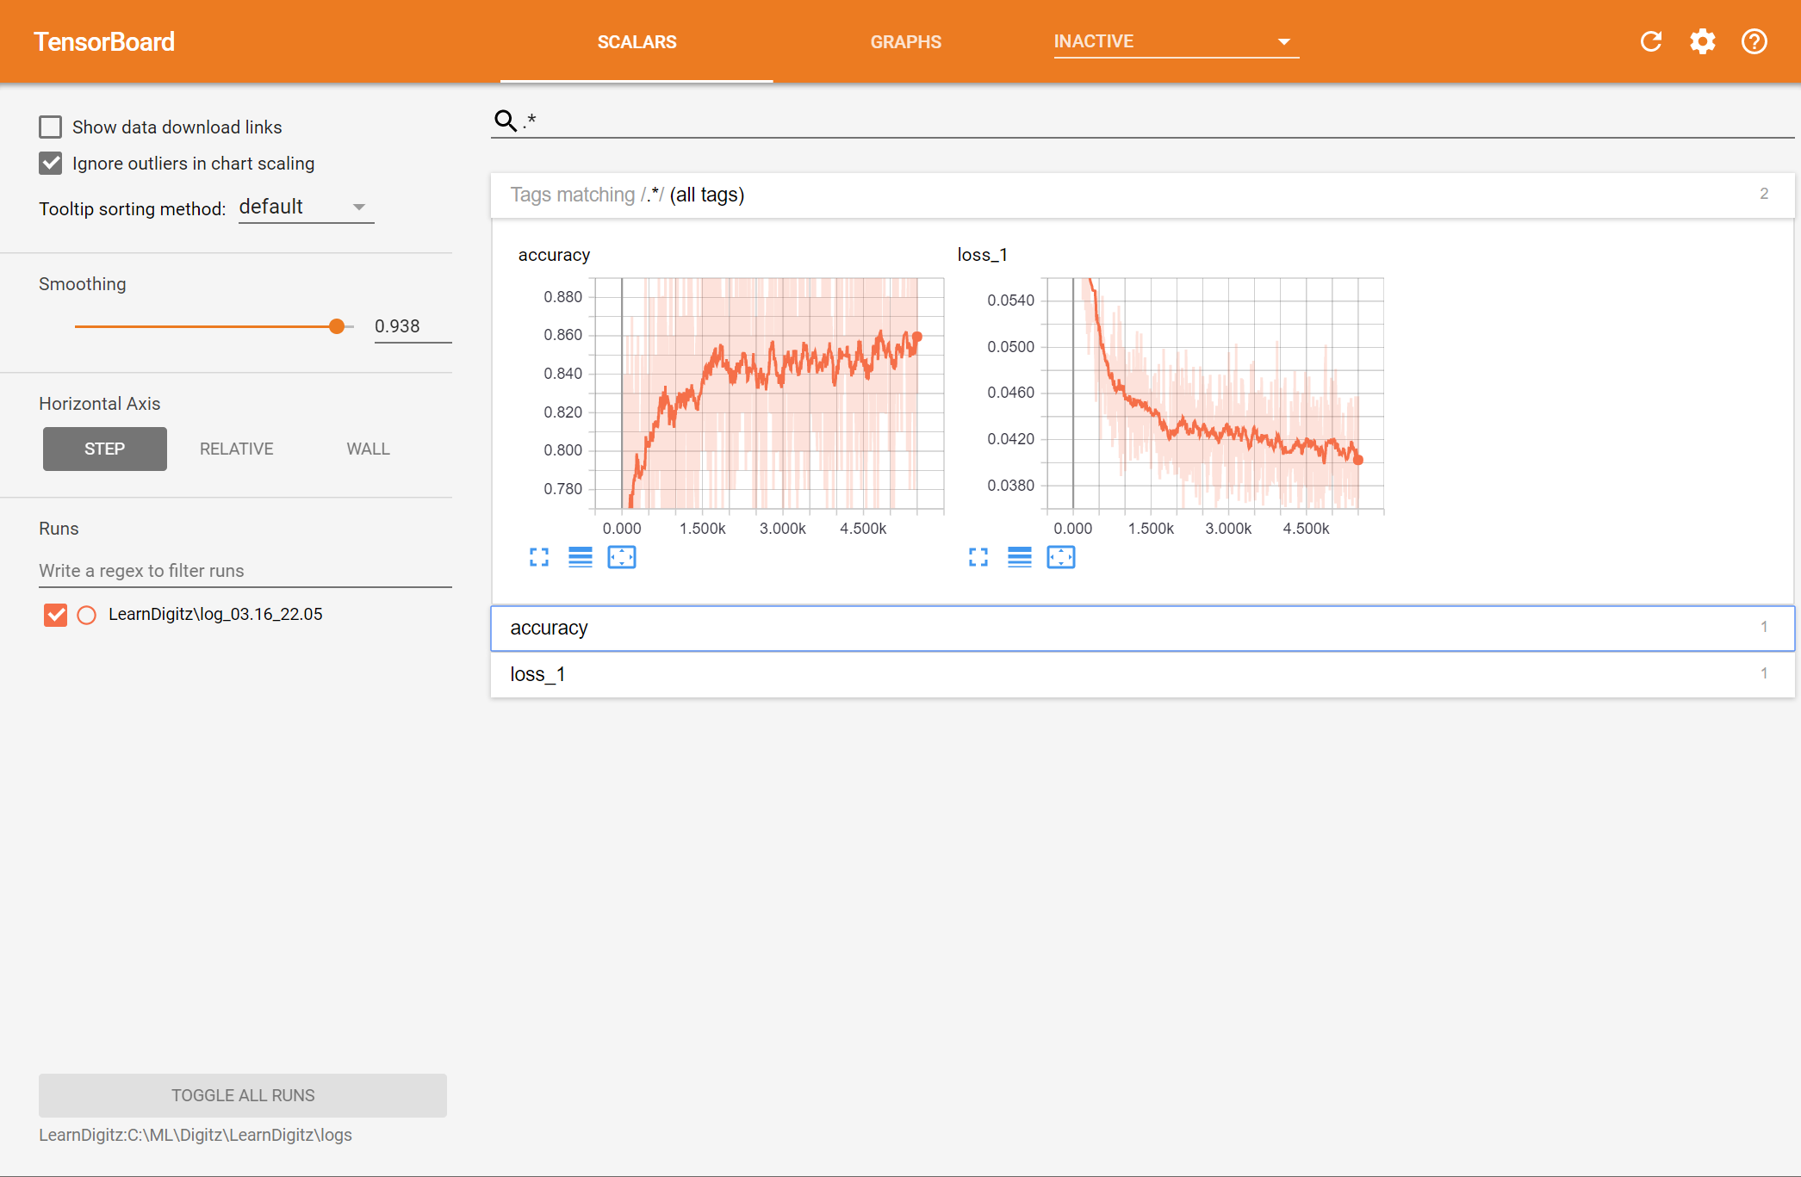

Slide 55
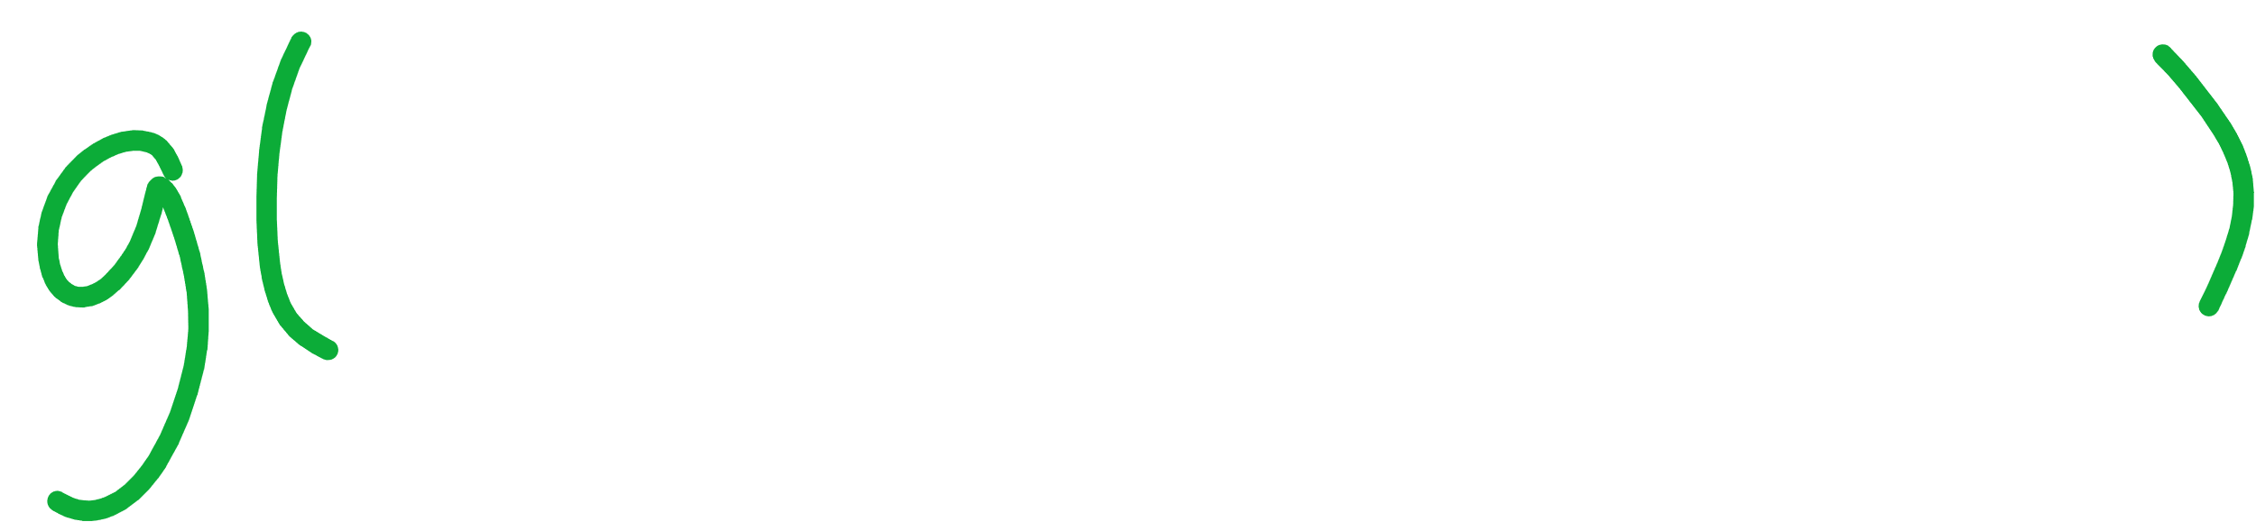

Slide 56
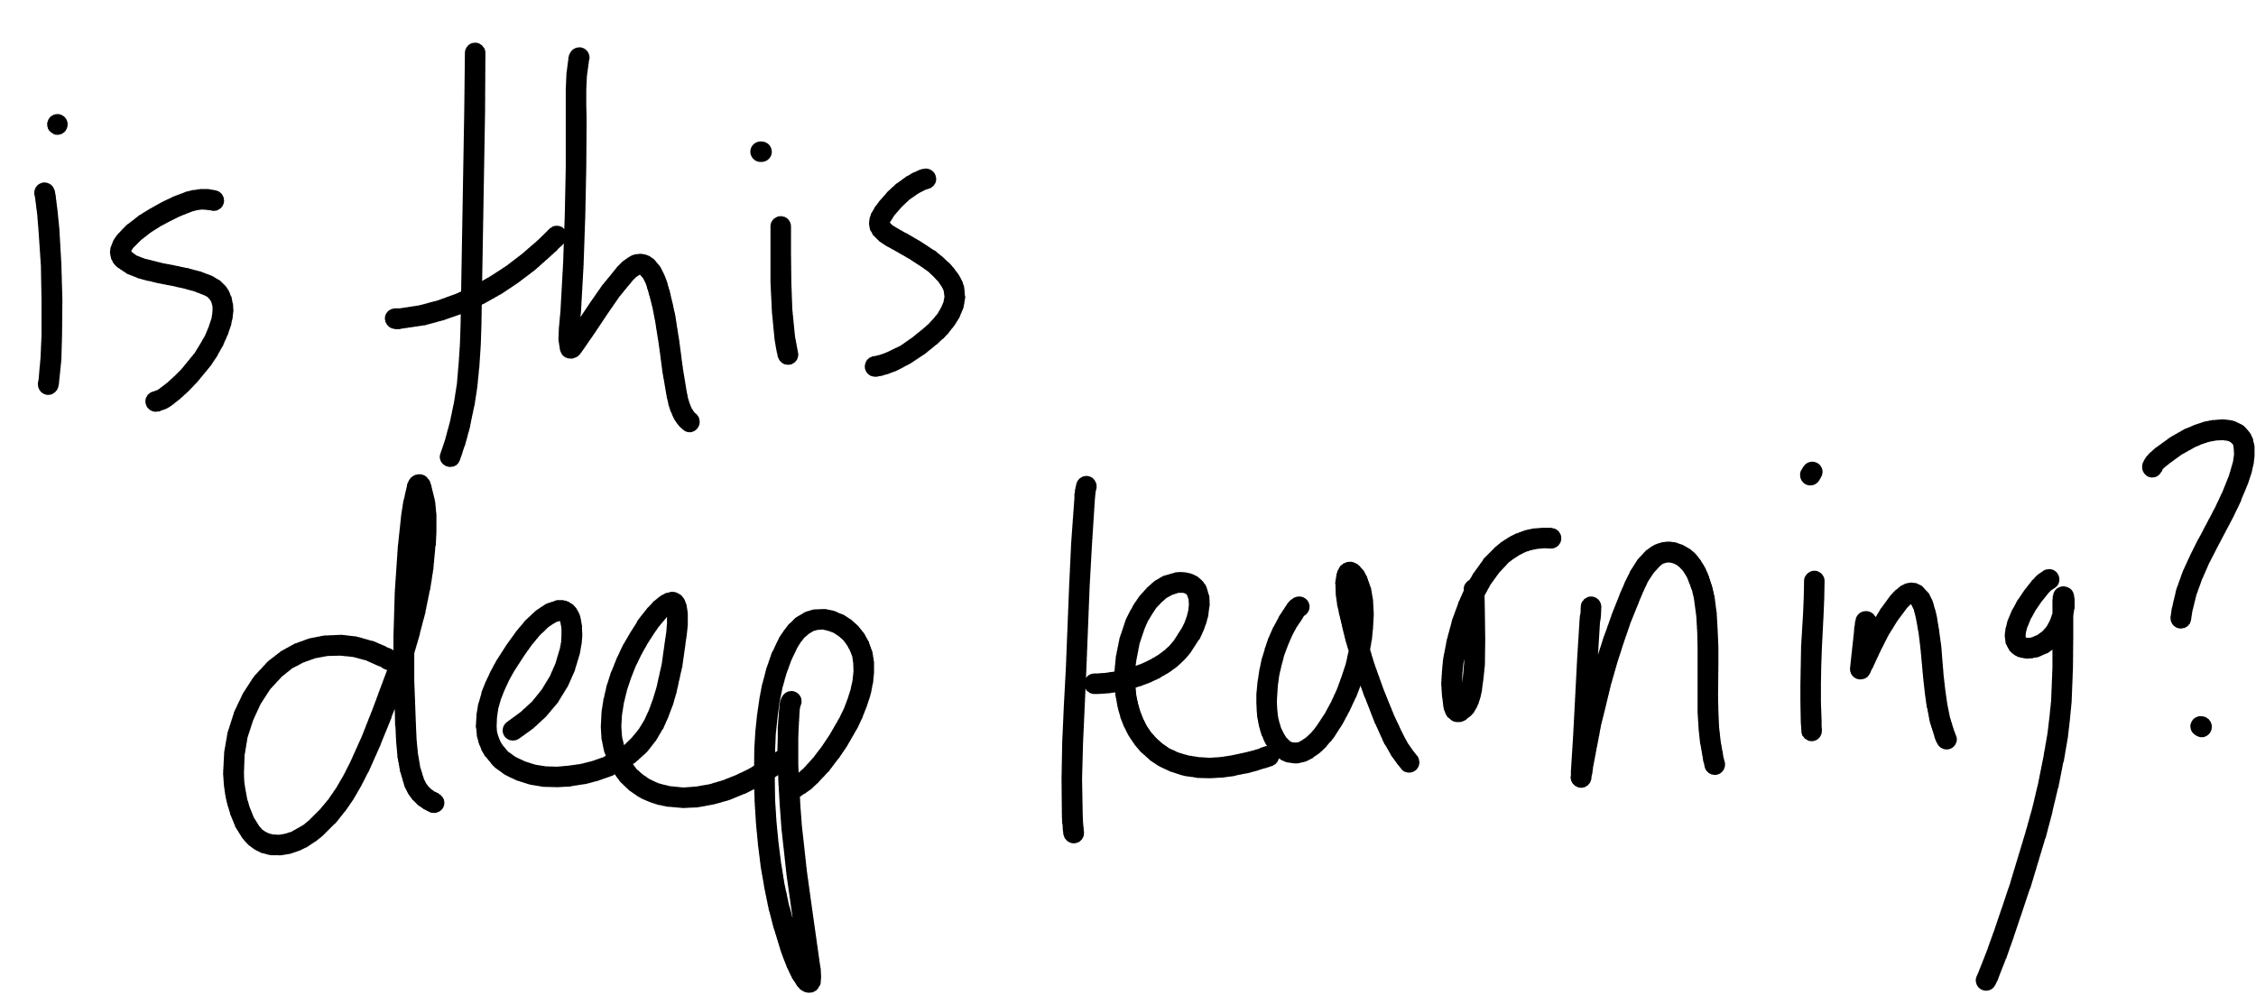

Slide 58
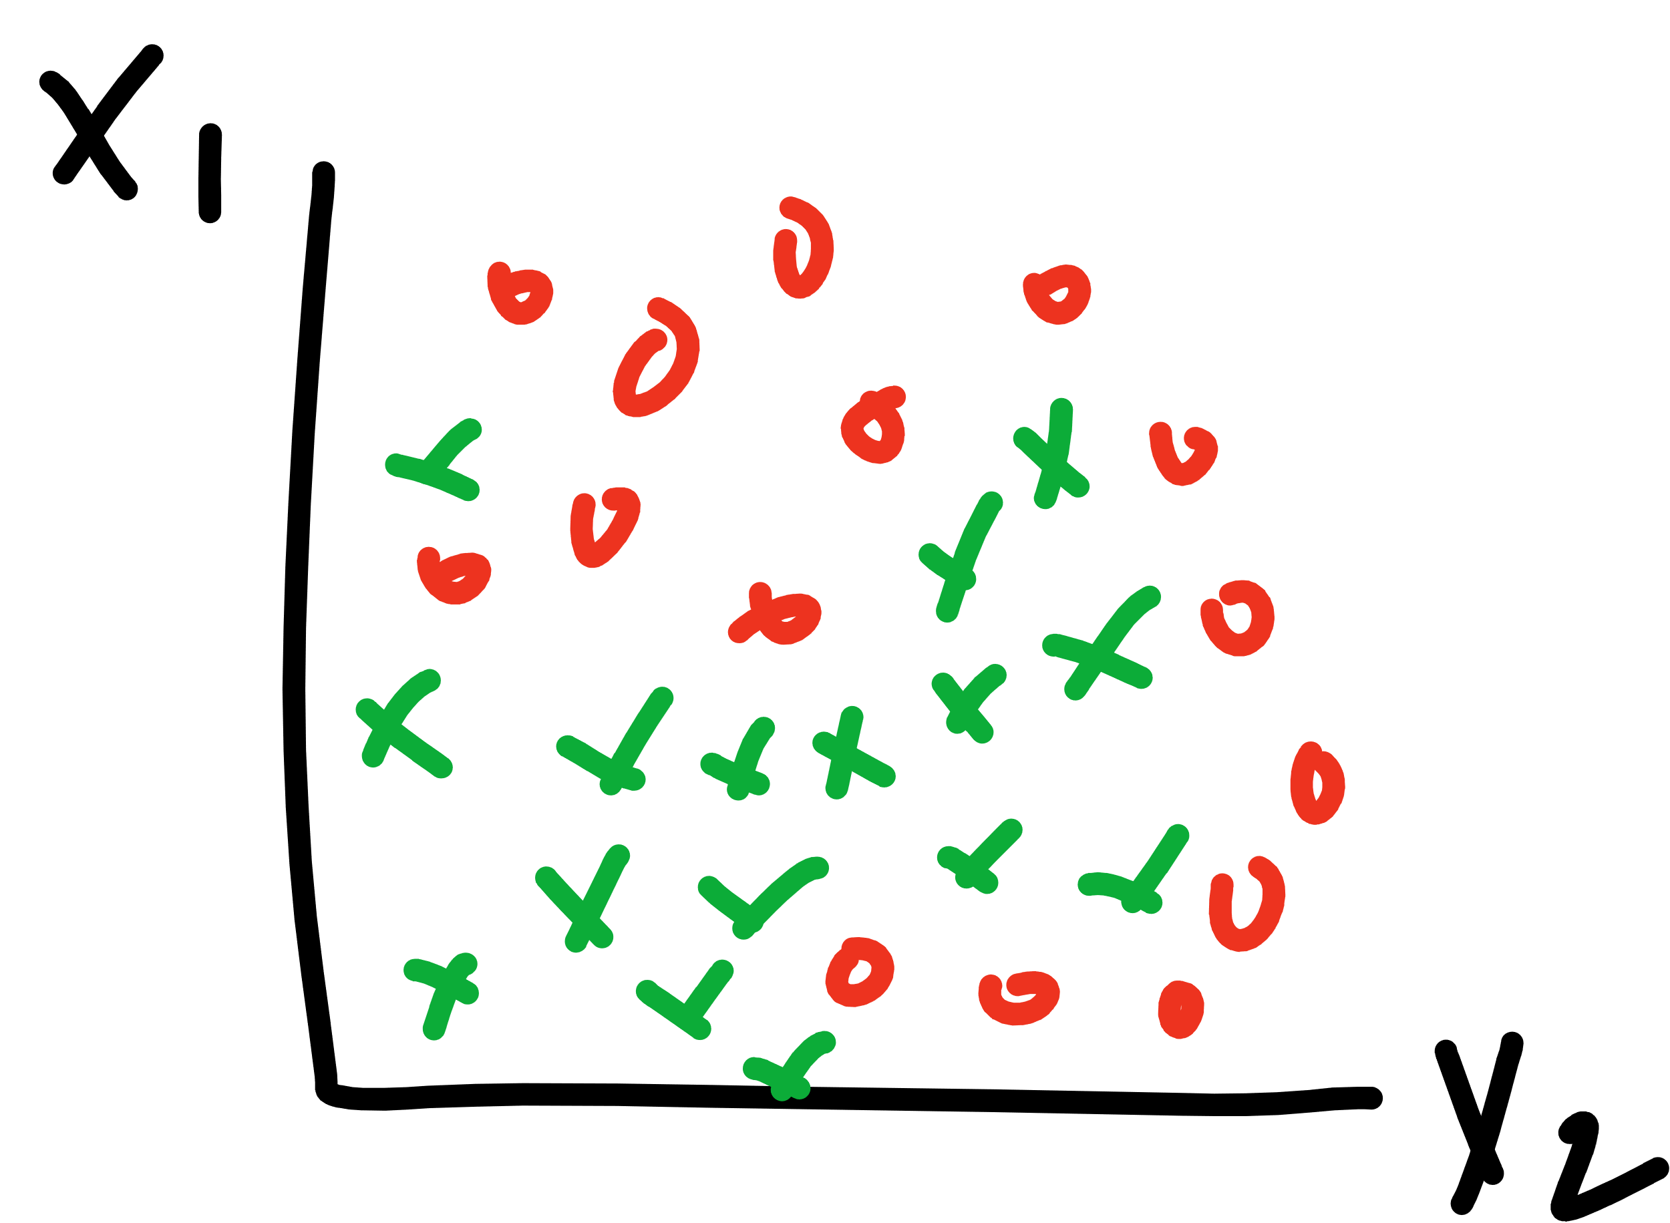

Slide 59
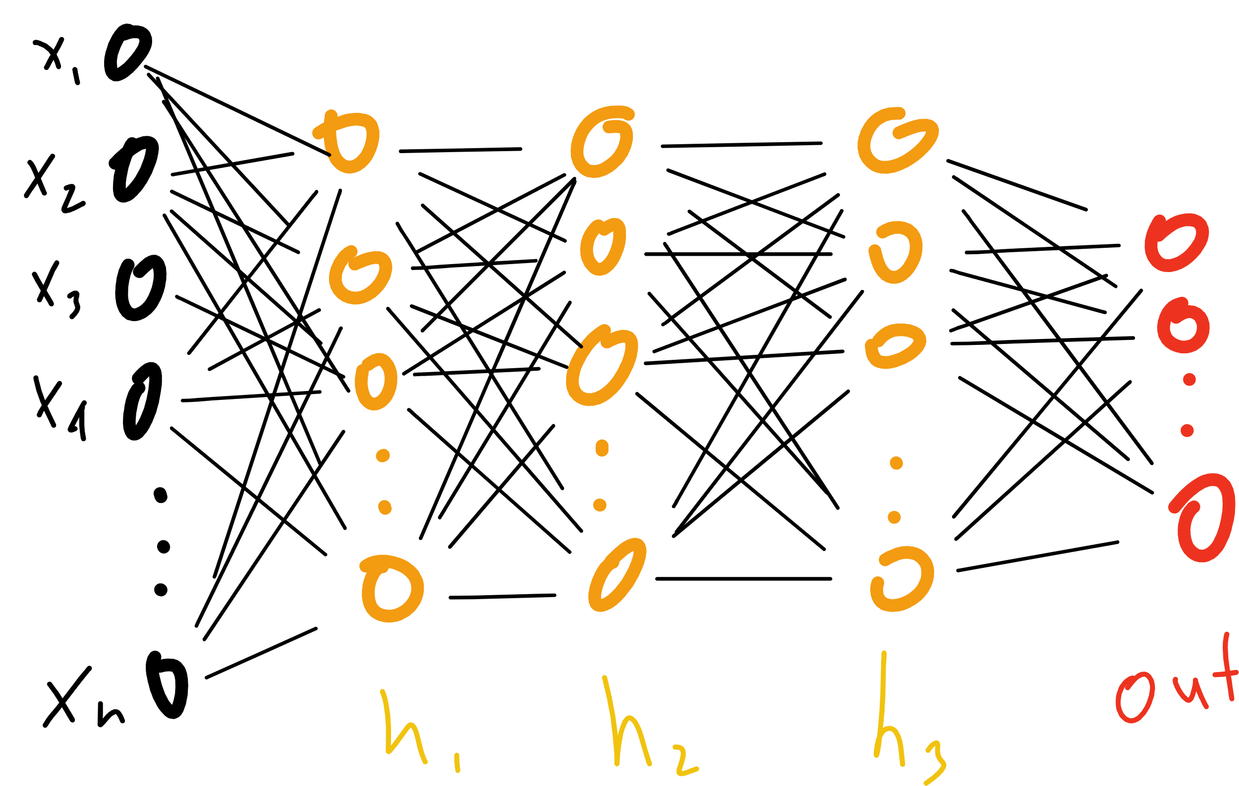

Slide 61
Notes:
Proof by induction

Slide 62
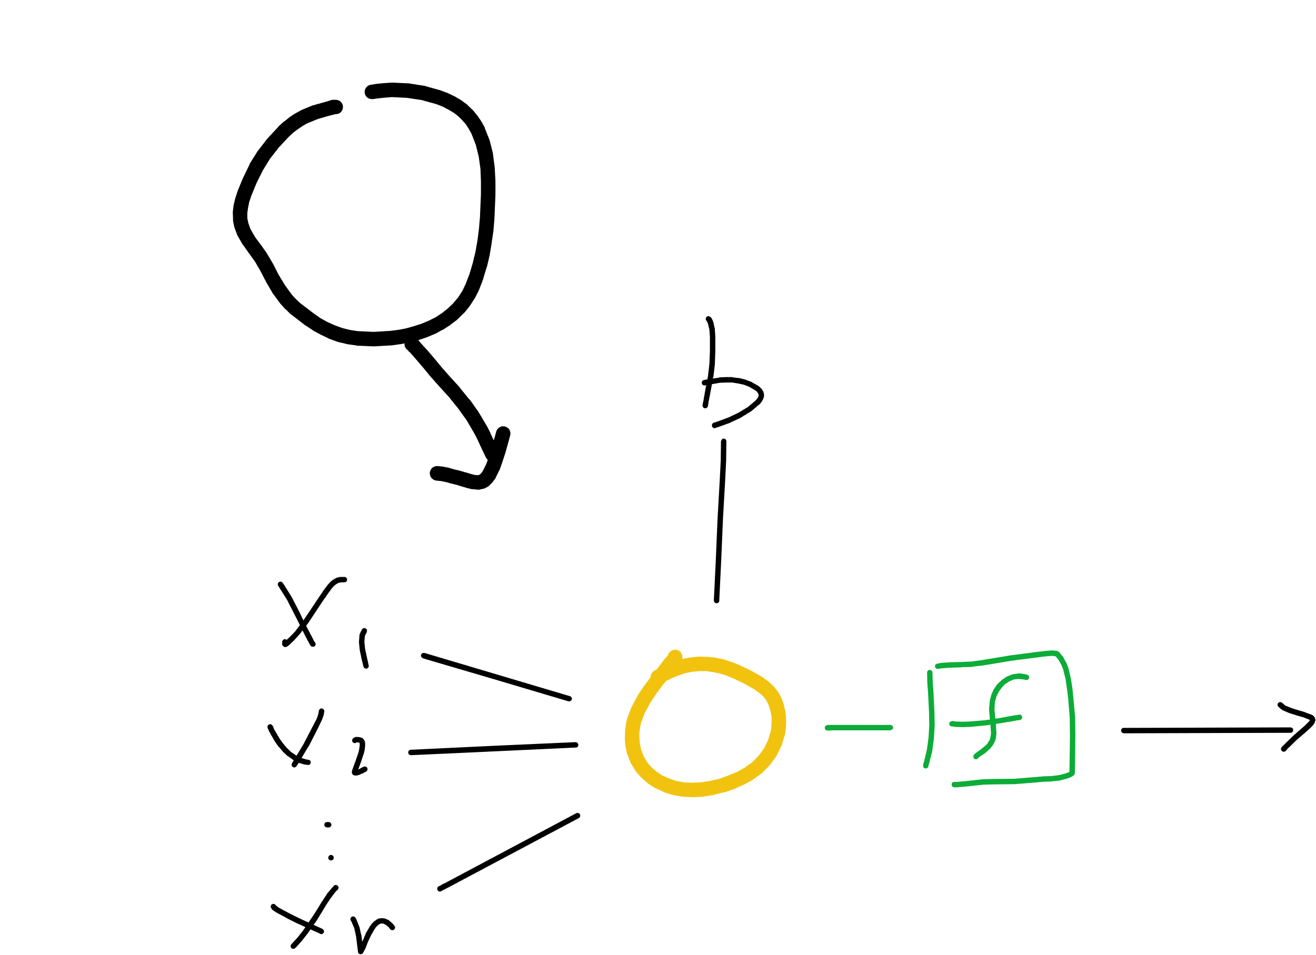
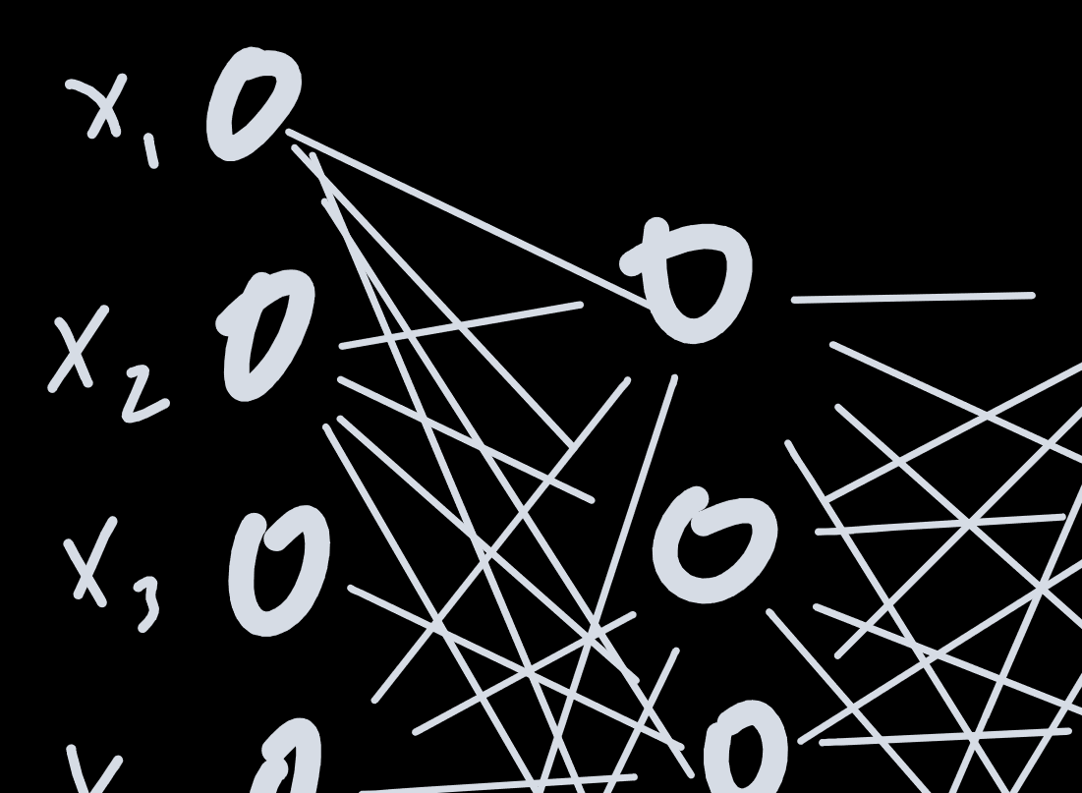
Notes:
Proof by induction

Slide 63
Notes:
Proof by induction

Slide 64
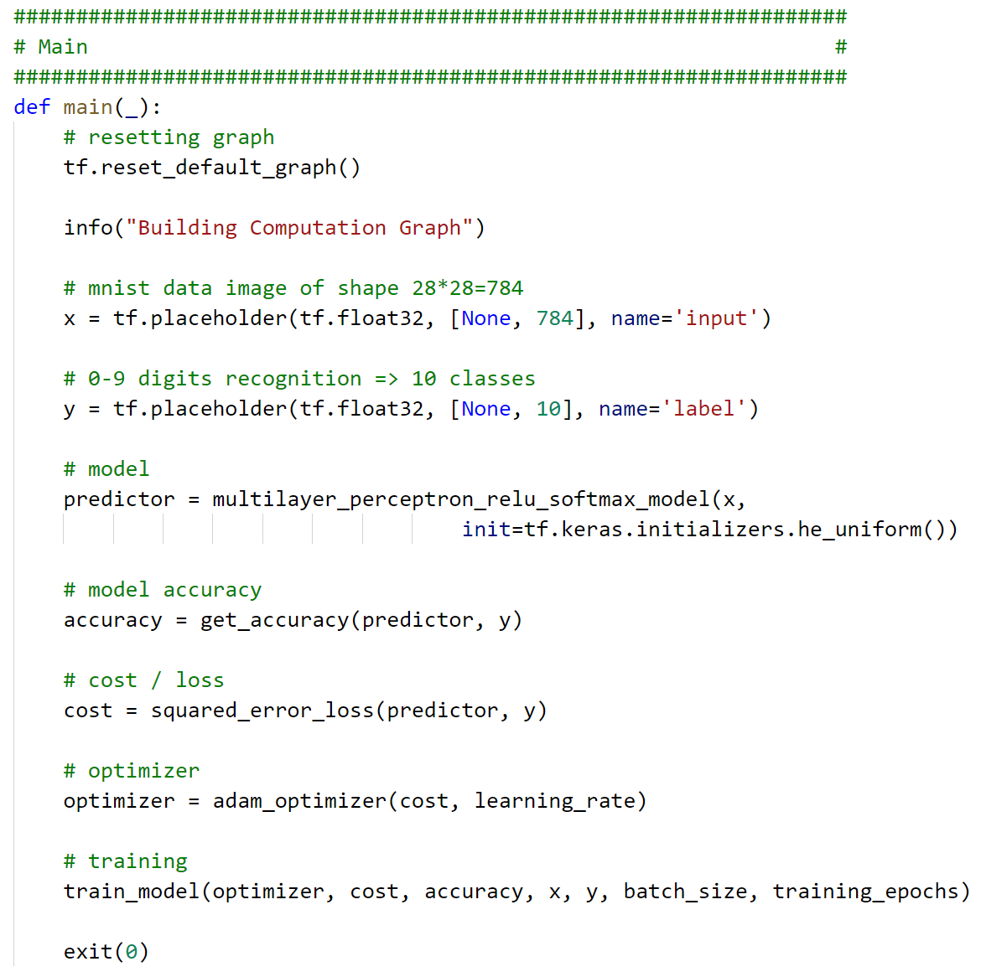

Slide 65
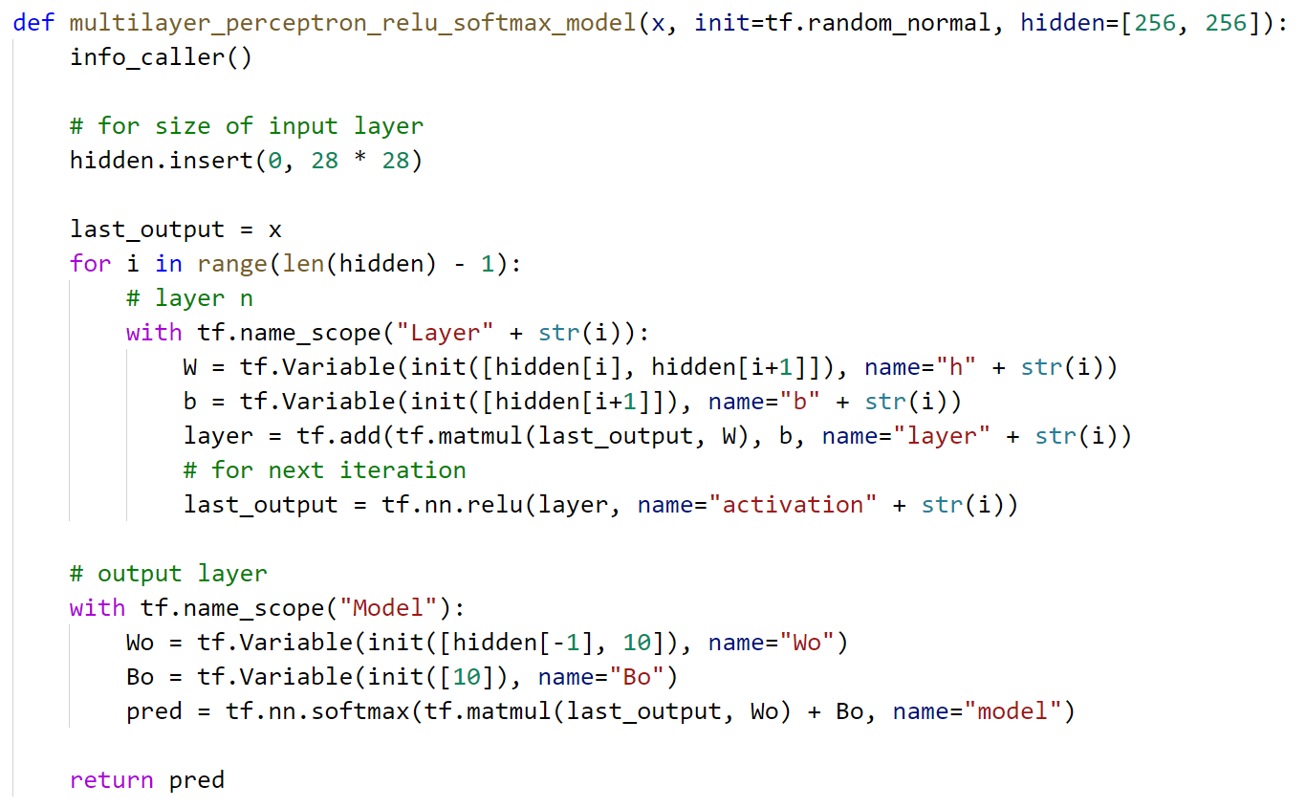


Slide 67


Slide 68


Slide 69


Slide 70
Notes:
Derivative?
Architecture

Slide 71


Slide 72
Notes:
Derivative?
Architecture

Slide 73



Slide 74



Slide 75


Slide 76

http://www.asimovinstitute.org/neural-network-zoo/

Slide 77

summary
machine learning is about finding $h(x)$ given examples instead of steps
deep learning is one way to do it!
we need:
  input $(x, y)$
  model function
  cost function
  optimization method

Slide 78
summary
TensorFlow is a framework that can help.
steps
  define graph
  start session
  run training

Slide 79
summary
Learn more about
  Cognitive Services – https://cda.ms/n4
  Azure ML – https://cda.ms/n5
  Deep Learning VMs - https://cda.ms/n6
  Batch AI – https://cda.ms/n7
  Windows ML – https://cda.ms/n8
Get a hold of me!
  seth.juarez@microsoft.com
  @sethjuarez

Slide 80

Seth Juarez
Microsoft
@sethjuarez

